Slide 1
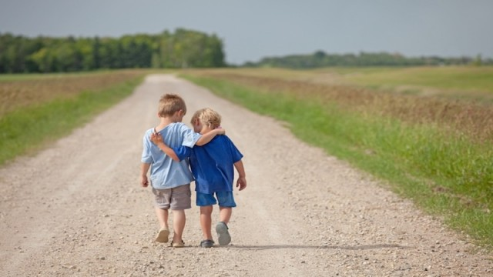

Slide 2
1 Thessalonians 5:15 See that no one repays another with evil for evil, but always seek after that which is good for one another and for all men.

Slide 3
How do I treat others?

Slide 4
John 14:26 “But the Helper, the Holy Spirit, whom the Father will send in My name, He will teach you all things, and bring to your remembrance all that I said to you.

Slide 5
Galatians 5:22 But the fruit of the Spirit is love, joy, peace, patience, kindness, goodness, faithfulness,

Slide 6
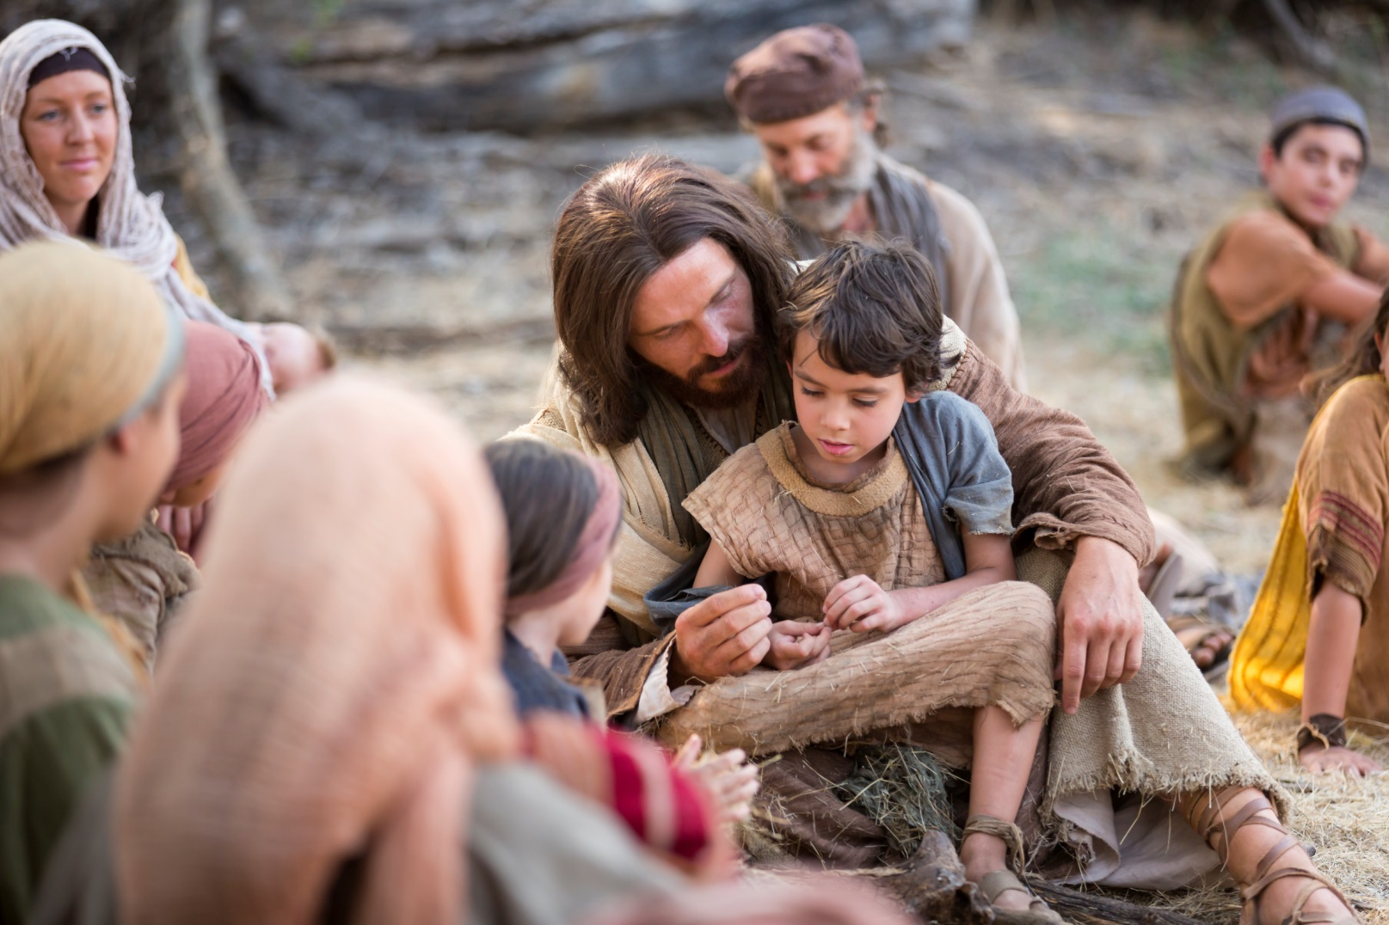
I want to be
more like Jesus

Slide 7
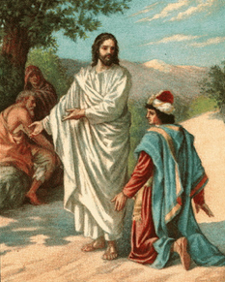
Matthew 19:17 And He said to him, “Why are you asking Me about what is good? There is only One who is good; but if you wish to
enter into life, keep the commandments.”

Slide 8
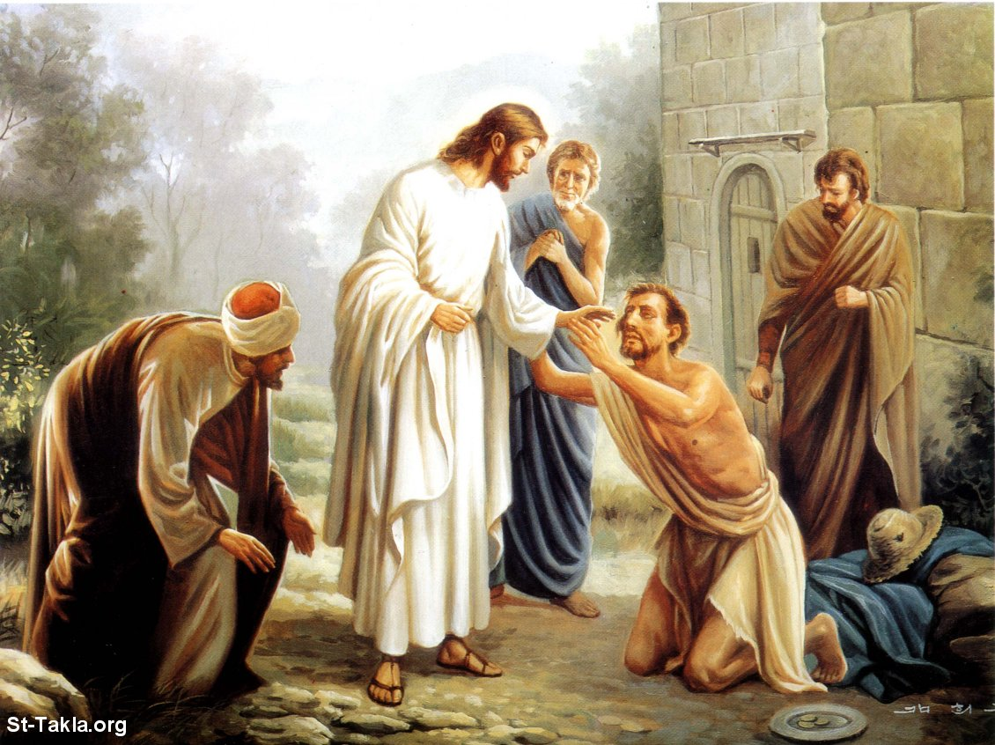
In every situation and circumstance, Jesus is God; therefore Jesus is good.

Slide 9
Luke 6:45 “The good man out of the good treasure of his heart brings forth what is good; and the evil man out of the evil treasure brings forth what is evil; for his mouth speaks from that which fills his heart.

Slide 10
I choose to be kind and good in my relationship with others.

Slide 11
Proverbs 26:23–25 Like an earthen vessel overlaid with silver dross Are burning lips and a wicked heart. He who hates disguises it with his lips, But he lays up deceit in his heart. When he speaks graciously, do not believe him, For there are seven abominations in his heart.

Slide 12
Life Changes

Slide 13
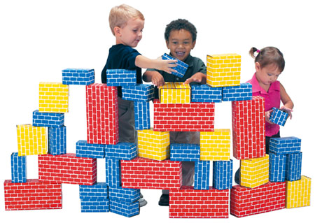
I choose to build others up.

Slide 14
1 Thessalonians 5:11 Therefore encourage one another, and build up one another, just as you also are doing.

Slide 15
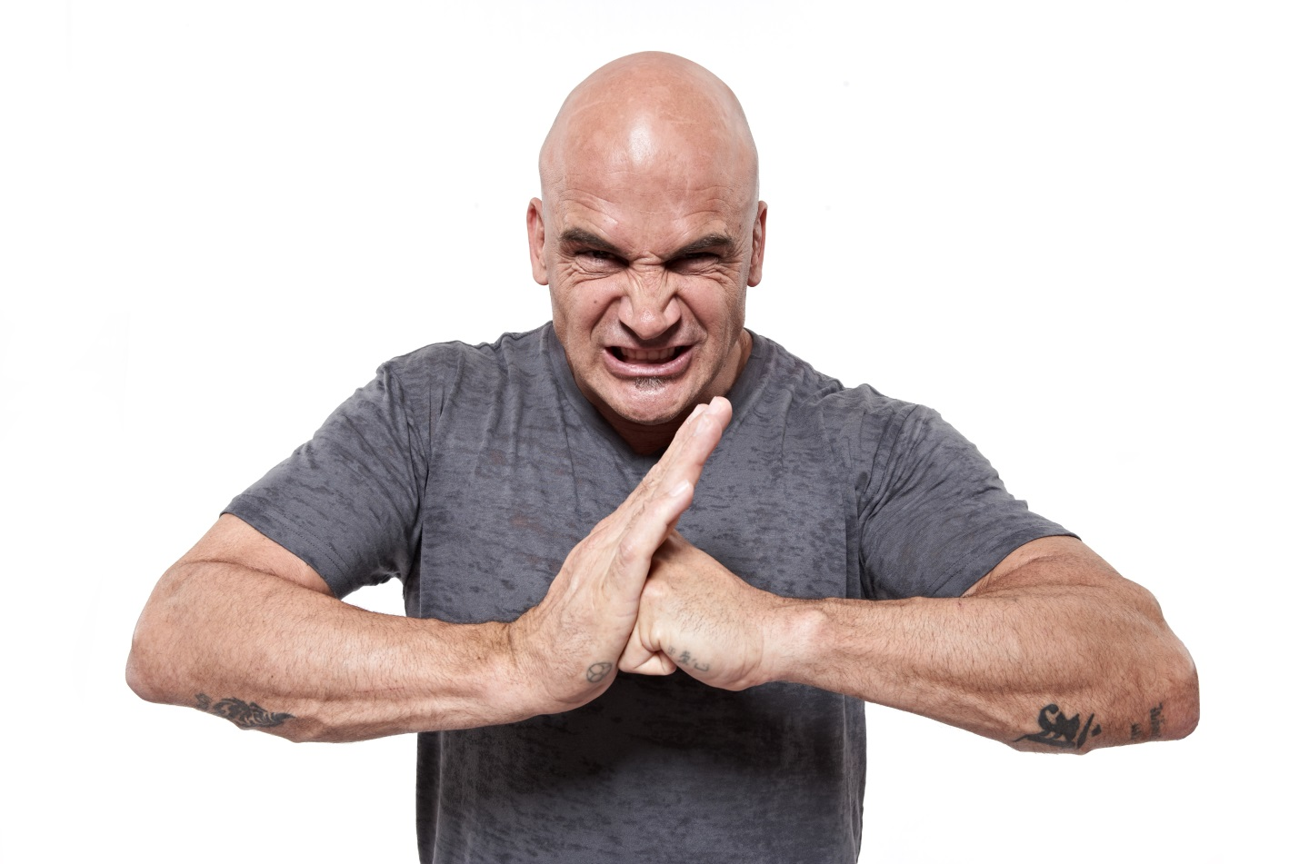
I choose NOT to pay back wrong for wrong.

Slide 16
1 Thessalonians 5:15 See that no one repays another with evil for evil, but always seek after that which is good for one another and for all men.

Slide 17
Romans 12:19–21 Never take your own revenge, beloved, but leave room for the wrath of God, for it is written, “Vengeance is Mine, I will repay,” says the Lord. “But if your enemy is hungry, feed him, and if he is thirsty, give him a drink; …

Slide 18
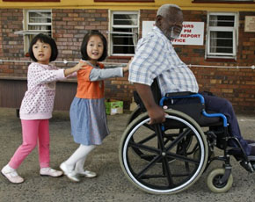
for in so doing you will heap burning coals upon his head.” Do not be overcome by evil, but overcome evil with good.

Slide 19
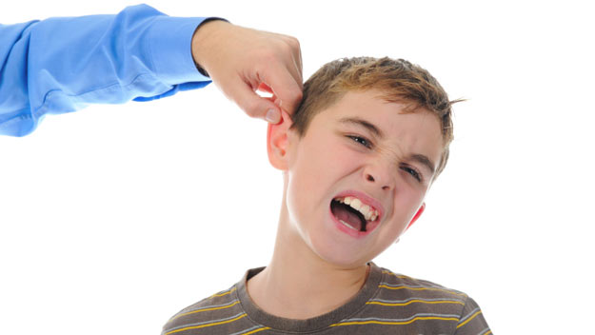
I choose to do the hard thing out of love.

Slide 20
Galatians 6:1 Brethren, even if a man is caught in any trespass, you who are spiritual, restore such a one in a spirit of gentleness; each one looking to yourself, lest you too be tempted.

Slide 21
Ephesians 4:15 but speaking the truth in love, we are to grow up in all aspects into Him, who is the head, even Christ,

Slide 22
Proverbs 27:6 Faithful are the wounds of a friend, But deceitful are the kisses of an enemy.

Slide 23
2 Thessalonians 1:11 To this end also we pray for you always that our God may count you worthy of your calling, and fulfill every desire for goodness and the work of faith with power;

Slide 24
2 Thessalonians 1:11 That is why we always pray for you, asking our God to help you live the kind of life he called you to live. We pray that with his power God will help you do the good things you want and perform the works that come from your faith.

