Slide 1
The Struggle With PRIDE
Is it your struggle?

Slide 2
So what do people have Good Pride in?

Slide 3
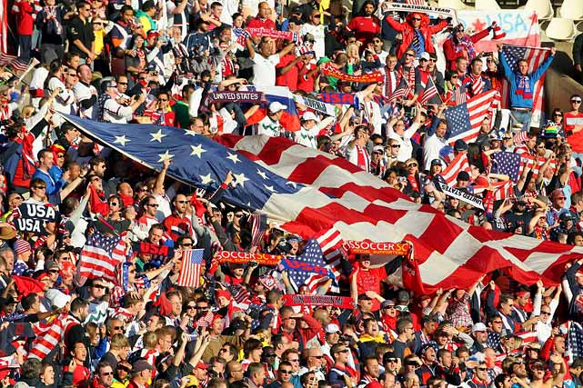

Slide 4
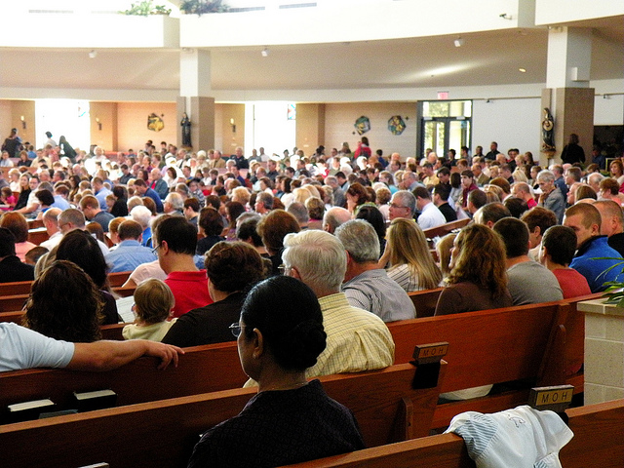
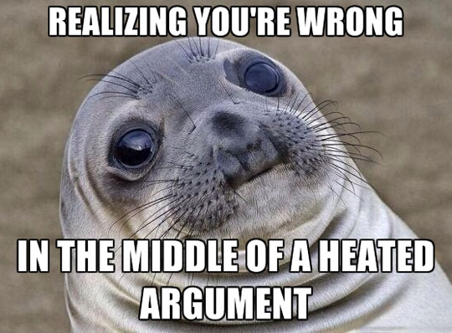
But then there is the Negative Side

Slide 5
Verses we have all read
Proverbs 11:2
² When pride comes, then comes shame; But with the humble is wisdom.
Proverbs 13:10
By pride comes nothing but strife, But with the well-advised is wisdom.
Proverbs 16:18
Pride goes before destruction, And a haughty spirit before a fall.

Slide 6
Proverbs 29:23
A man’s pride will bring him low, But the humble in spirit will retain honor

Slide 7
MARK 7
¹⁴ When He had called all the multitude to Himself, He said to them, “Hear Me, everyone, and understand: ¹⁵ There is nothing that enters a man from outside which can defile him; but the things which come out of him, those are the things that defile a man. ¹⁶ If anyone has ears to hear, let him hear!”^{[f]}
¹⁷ When He had entered a house away from the crowd, His disciples asked Him concerning the parable. ¹⁸ So He said to them, “Are you thus without understanding also? Do you not perceive that whatever enters a man from outside cannot defile him, ¹⁹ because it does not enter his heart but his stomach, and is eliminated, thus purifying all foods?”^{[g]} ²⁰ And He said, “What comes out of a man, that defiles a man. ²¹ For from within, out of the heart of men, proceed evil thoughts, adulteries, fornications, murders, ²² thefts, covetousness, wickedness, deceit, lewdness, an evil eye, blasphemy, pride, foolishness. ²³ All these evil things come from within and defile a man.”

Slide 8
1 Timothy 3
3 This is a faithful saying: If a man desires the position of a bishop, he desires a good work. ² A bishop then must be blameless, the husband of one wife, temperate, sober-minded, of good behavior, hospitable, able to teach; ³ not given to wine, not violent, not greedy for money, but gentle, not quarrelsome, not covetous; ⁴ one who rules his own house well, having his children in submission with all reverence ⁵ (for if a man does not know how to rule his own house, how will he take care of the church of God?); ⁶ not a novice, lest being puffed up with pride he fall into the same condemnation as the devil. ⁷ Moreover he must have a good testimony among those who are outside, lest he fall into reproach and the snare of the devil.

Slide 9
JAMES 4
4 Where do wars and fights come from among you? Do they not come from your desires for pleasure that war in your members? ² You lust and do not have. You murder and covet and cannot obtain. You fight and war. Yet you do not have because you do not ask. ³ You ask and do not receive, because you ask amiss, that you may spend it on your pleasures. ⁴ Adulterers and adulteresses! Do you not know that friendship with the world is enmity with God? Whoever therefore wants to be a friend of the world makes himself an enemy of God. ⁵ Or do you think that the Scripture says in vain, “The Spirit who dwells in us yearns jealously”?
⁶ But He gives more grace. Therefore He says:
“God resists the proud, But gives grace to the humble.”
⁷ Therefore submit to God. Resist the devil and he will flee from you. ⁸ Draw near to God and He will draw near to you. Cleanse your hands, you sinners; and purify your hearts, you double-minded. ⁹ Lament and mourn and weep! Let your laughter be turned to mourning and your joy to gloom. ¹⁰ Humble yourselves in the sight of the Lord, and He will lift you up.

