Slide 1
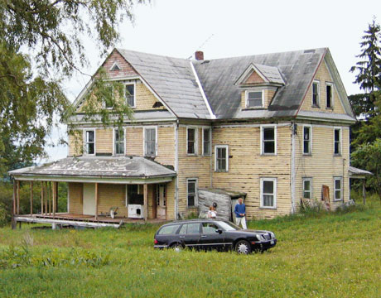
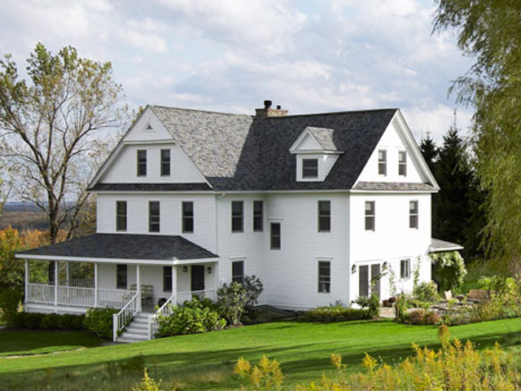
Change Us

Slide 2
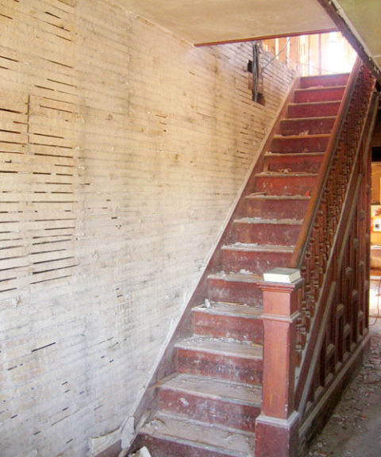
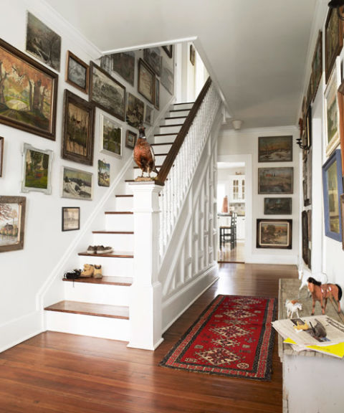
Change Us

Slide 3
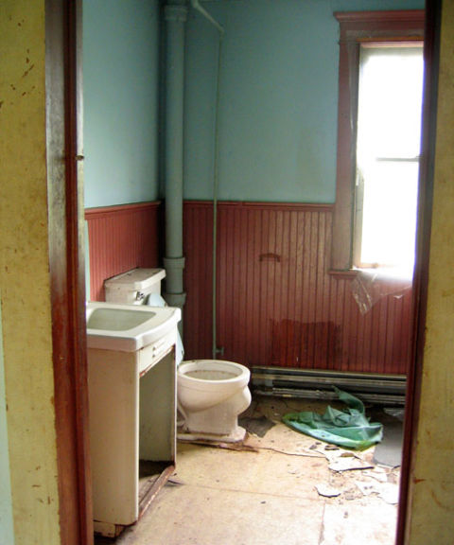
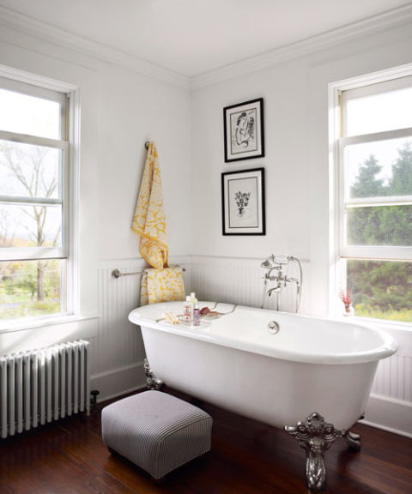
Change Us

Slide 4
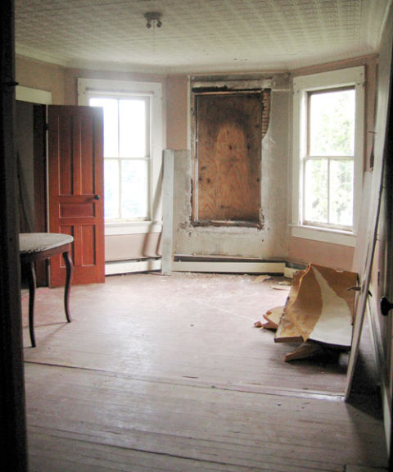
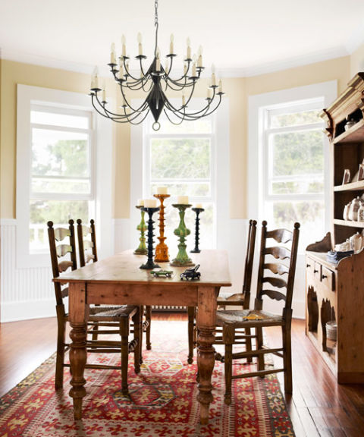
Change Us

Slide 5
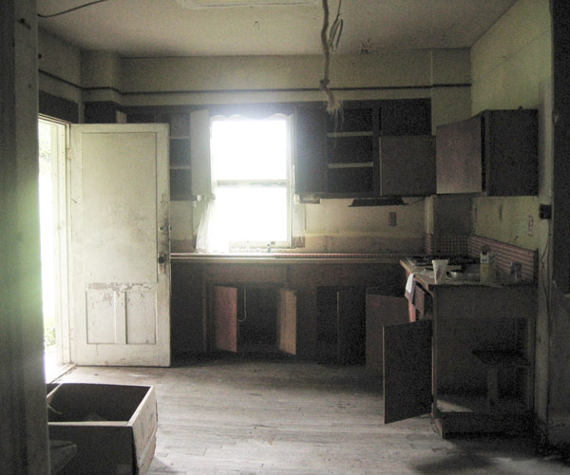
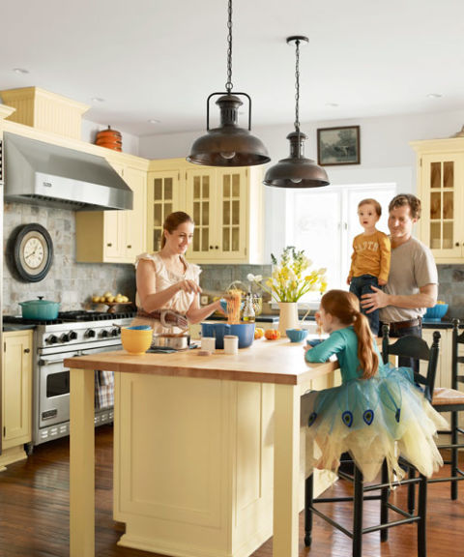
Change Us

Slide 6
Change Us
Text: Titus 2:11-14
Like this house, we also can be transformed!
Notice what our text describes:
Who can bring about this change?
How many people are candidates for change?
What kind of change happens?

Slide 7
Change Us
Jesus Christ our great God and Savior will…
REDEEM US
Buy us back
PURIFY US
Clean us up
USE US
Put us to good use

Slide 8
Change Us
Jesus Christ our great God and Savior will…
CHANGE OUR
Status
Attitude
Effectiveness
TRANSFORM US FROM:
Lawbreakers to good citizens
Worthless to valuable
Helpless to hopeful

