Slide 1
My Relationship with God
Text: Ephesians 5:1-10
Many beautiful passages in Psalms speak to David’s relationship with God.
Psalm 18:1-3
Psalm 21:1-7
Psalm 23
In Ephesians we are shown by Paul the type of relationship we should have with God.
Today, we are going to explore what Paul says.

Slide 2
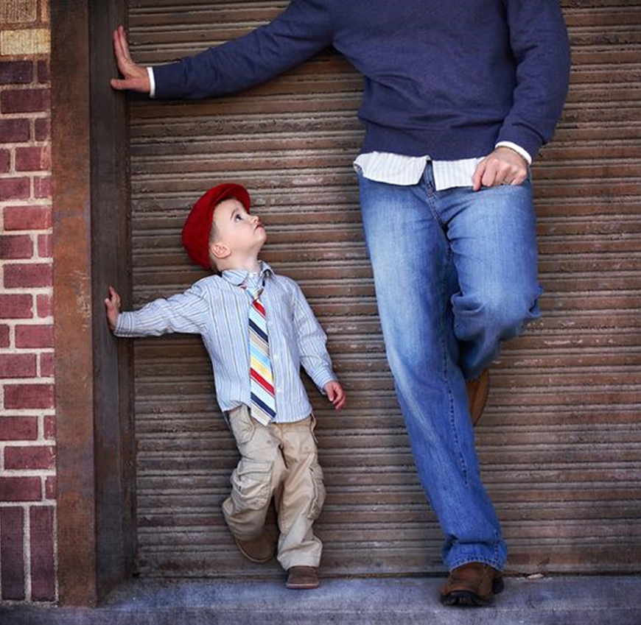
My Relationship with God
Involves the……………………….
ART OF IMITATION
Eph. 5:1-2
As Beloved Children
The way God loves, you love others.
I Peter 1:15

Slide 3
My Relationship with God
Involves the……………………….
ACT OF OBEDIENCE
Eph. 5:3-6
John 3:36
I Peter 1:14
Romans 1:5
Rom. 6:17

Slide 4
My Relationship with God
Involves the……………………….
AFFINITY TO FAITHFULNESS
Eph. 5:7-8
Often our relationship to God in a spiritual sense is compared to a marriage.
We certainly don’t want to partner with the world.
Consider Hosea 3:1 and Eph. 5:5

Slide 5
My Relationship with God
Involves the……………………….
ATTITUDE OF PLEASING
Eph. 5:10
I want with all my being to please God.
I am trying to discern how to do that.
I am putting forth effort not because I have to but because I want to please Him.

