Slide 1
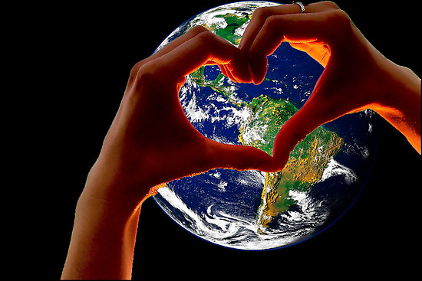
Conquering the World with Love
Text: I Corinthians 13:1-7
Romans 8:37
We are more than conquerors! Why?
JESUS’S LOVE
Paul wants us to employ the same tactic.

Slide 2
Conquering the World with Love
Means……………………………….
TREATING THE WORLD WITH KINDNESS
I Cor. 13:4
Patience
Not irritable, rude
Not resentful
Eph. 4:32
Matt. 5:38-44

Slide 3
Conquering the World with Love
Means……………………………….
APPROACHING THE WORLD WITH HUMILITY
I Cor. 13:4-5
Is not arrogant.
Does not boast.
Does not insist on its own way.
Phil. 2:3-4

Slide 4
Conquering the World with Love
Means……………………………….
FACING THE WORLD WITH FAITH
I Cor. 13:7
Believe the best of folks.
Want what’s best for people.
We are sometimes skeptical creatures.
All the wrongs of this world can be righted through the truth of God’s word.

Slide 5
Conquering the World with Love
Conclusion:
Romans 5:8
Love never ends.
God’s love didn’t end with Peter’s denial.
God’s love didn’t end when the only begotten Son was brutally tortured and murdered for a world full of ingrates

