Slide 1
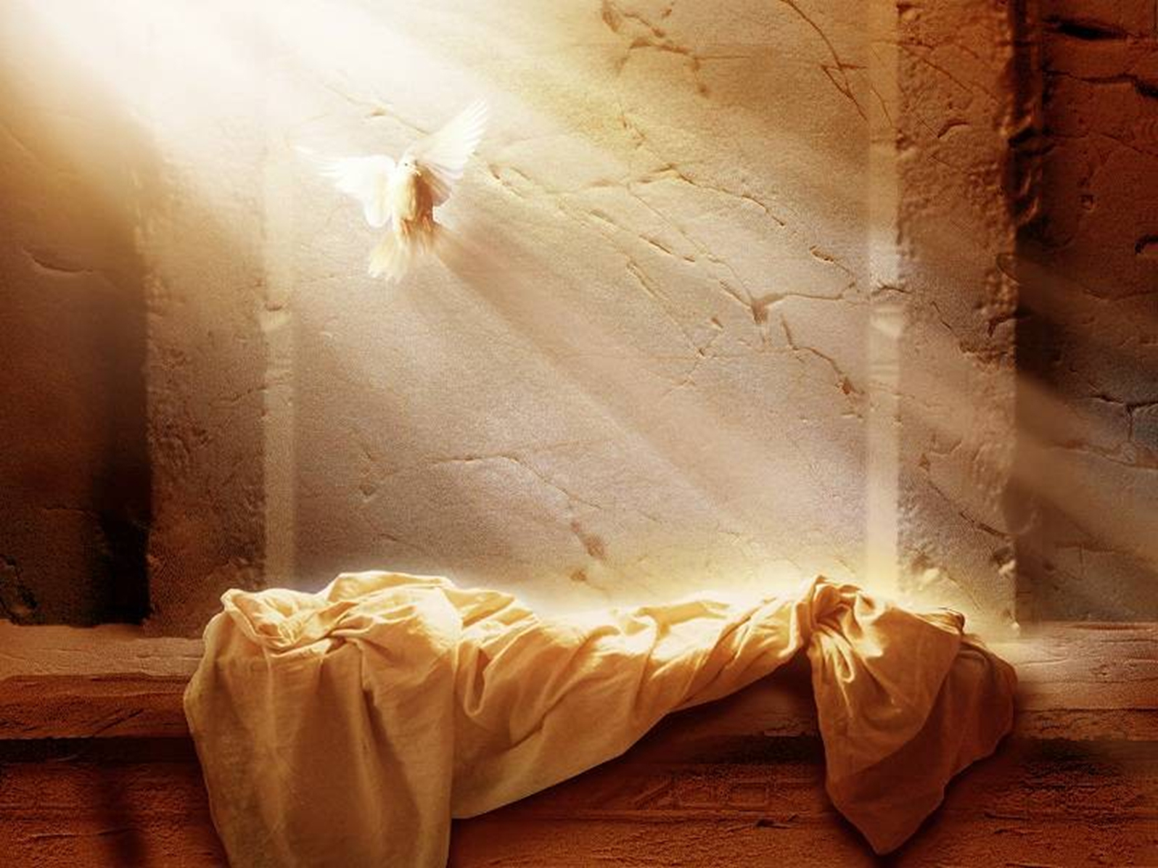
The God of all possibilities
THE RESURRECTION:
Making the impossible possible.
The resurrection opens the door for all possibilities.
It is proof that anything is possible.
It makes all things believable!!

Slide 2
The God of all possibilities
If we can believe in the resurrection then..
A virgin birth doesn’t seem so far-fetched.
Luke 1:34-37
A Rich man’s salvation doesn’t seem so incredible.
Matt. 19:26
The creation of an entire universe doesn’t have to lead to such skepticism.
Gen. 1:1

Slide 3
The God of all possibilities
But should this surprise us?
Consider:
Gen. 18:14
Job 42:2
Jer. 32:17,27
Mark 14:36
The continuing theme of these passages is the “almighty” power of God.

Slide 4
The God of all possibilities
Notice what the resurrection assures us of..
THE JUDGEMENT-
Acts 17:31, Heb. 9:27, II Cor. 5:10
FREEDOM FROM THE PANGS OF DEATH-
Acts 2:24
FORGIVENESS OF SINS IN BAPTISM-
Col. 2:12, I Peter 3:21
ETERNAL LIFE
I Cor. 15:19, I Peter 1:3

