Slide 1
Warren Wiersbe
“The ability to calm your soul and wait before God is one of the most difficult things in the Christian life. Our old nature is restless...the world around us is frantically in a hurry. But a restless heart usually leads to a reckless life.”

Slide 2
Imagine you had 86,400 pennies to spend every day. $864.00.
You do have 86,400 seconds to spend every day

Slide 3
Benjamin Franklin
“Do not squander time, for it is the stuff life is made of.”

Slide 4
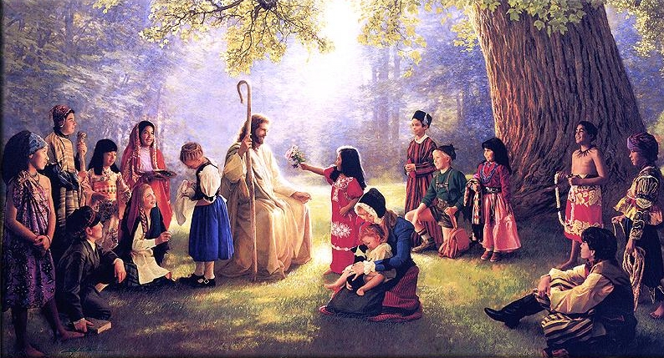
Why wasn’t Jesus ever in a hurry ?
He was doing the most important job in history

Slide 5
We always think we’ll have plenty of time……
Sometime in the future
https://www.youtube.com/watch?v=4-kawBLVSTA

Slide 6
Billy Graham
“Time is the capital that God has given us to invest.
People are the stocks in which we are to invest our time, whether they’re blue chips or penny stocks or even junk bonds.”

Slide 7
168 hours in a week
56 hours sleeping = 8 hrs / day
21 hours eating/getting ready = 3 hrs/ day
50 working/travelling = 7 hrs / day
That leaves you with between 5 and 6 hours
a day for something else

Slide 8
If I followed you around for 2 weeks during those 5-6 hours a day….
I would be able to tell you what was most
important to you in your life.

Slide 9
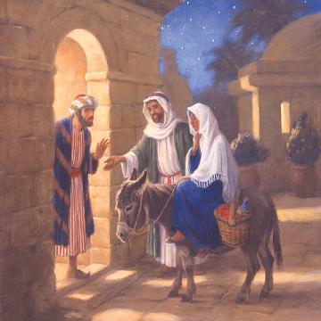
We’re sometimes like the Inn Keeper

Slide 10
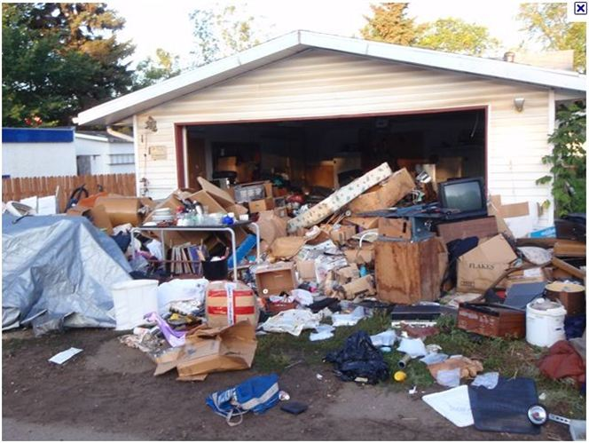
Do you have Room in Your Life for Jesus ?
Do you have Room in Your Life for Prayer ?

Slide 11
https://www.youtube.com/watch?v=6_N_uvq41Pg

Slide 12
Ephesians 5:14- 15 - See then that you walk circumspectly, not as fools, but as wise, redeeming the time because the days are evil.
Psalm 90:12 - So teach us to number our days, that we may apply our hearts unto wisdom.

