Slide 1
Noahide Laws
Do not deny God.
Do not blaspheme God.
Do not murder.
Do not engage in incestuous, adulterous or homosexual relationships.
Do not steal.
Do not eat of a live animal.
Establish courts/legal system to ensure law and
obedience.

Slide 2
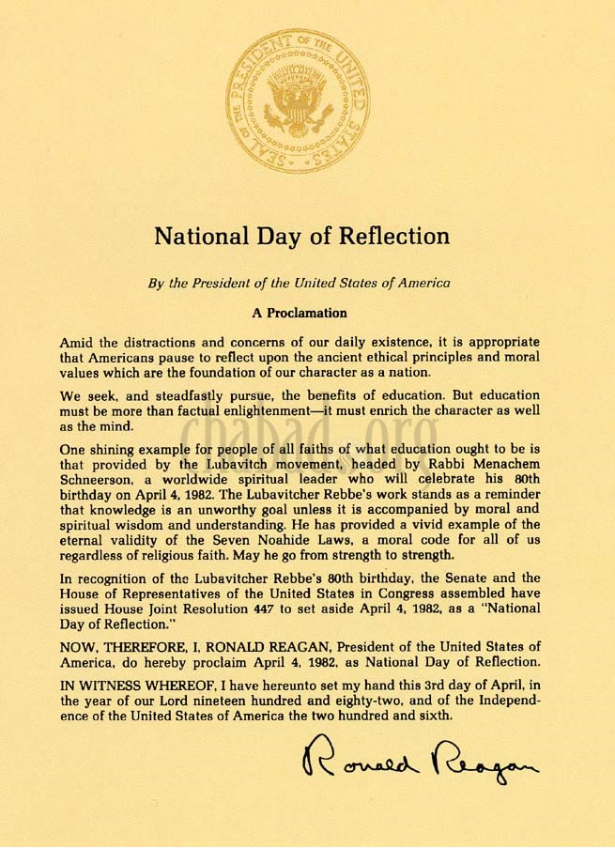

Slide 3
Noahide Laws
United States Congress
The Seven Laws of Noah were recognized by the United States Congress in the preamble to the 1991 bill that established Education Day in honor of the birthday of Rabbi Menachem Mendel Schneerson, the leader of the Chabad movement:
Whereas Congress recognizes the historical tradition of ethical values and principles which are the basis of civilized society and upon which our great Nation was founded; Whereas these ethical values and principles have been the bedrock of society from the dawn of civilization, when they were known as the Seven Noahide Laws.^{[55]}

Slide 4
Noahide Laws
Whereas without these ethical values and principles the edifice of civilization stands in serious peril of returning chaos;
Whereas society is profoundly concerned with the recent weakening of these principles that has resulted in crises that beleaguer and threaten the fabric of civilized society;
Whereas the justified preoccupation with these crises must not let the citizens of this Nation lose sight of their responsibility to transmit these historical ethical values from our distinguished past to the generations of the future;

Slide 5
Patriarchal Laws
Law of obedience to God- Gen. 2:16-17
Law of work- Gen. 2:15; 3:17-19
Law of theft- Gen. 2:16
Law of marriage- Gen. 2:24
Law of worship- Gen. 4:3-5; 8:20, Heb. 11:4
Law of murder- Gen. 4; 9:6
Law of eating live animals- Gen. 9:4; Acts 15

