Slide 1
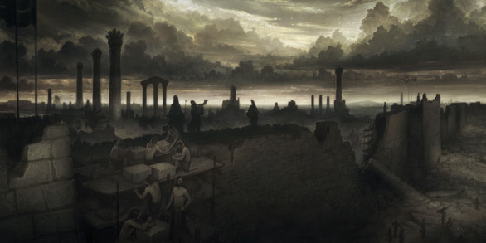
Varied Reactions to the work of God’s People
Some people…………
ARE ANGERED BY IT
Neh. 4:1
Acts 7:54
Acts 19:23-28

Slide 2
Varied Reactions to the work of God’s People
Some people…………
RIDICULE IT
Neh. 4:1
II Chron. 30:10
Jeremiah 20:7
Mark 9:40
Acts 17:32

Slide 3
Varied Reactions to the work of God’s People
Some people…………
ARE SKEPTICAL OF IT
Neh. 4:2
II Kings 7:2
Matt. 13:58
Luke 22:67

Slide 4
Varied Reactions to the work of God’s People
Some people…………
UNDERESTIMATE THE STRENGTH OF IT
Neh. 4:3
John 9:32-34
Dan. 3:15
Matt. 13:55
I Sam. 17:28, 42-43

Slide 5
Varied Reactions to the work of God’s People
Some people…………
BELIEVE IN IT
Neh. 4:6
I Cor. 9:24-25
Phil. 3:13-14
Acts 18:8

