Slide 1
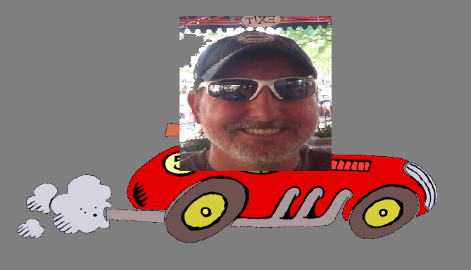
Servants For Life

Slide 2
Servant: A person who performs
duties for others.
A devoted and helpful
follower or supporter.
Synonyms: helper, supporter, follower

Slide 3
What reasons do we have to Serve God?
1. God Created Us
2. God gave us Jesus
John 3:16 - For God so loved a certain bunch
of people that he choose a random person
so that if a certain group of people that he
chose checked off all the stuff on God’s list
they got to go to heaven.

Slide 4
John 3:16 - For God so loved the world, that
he gave his only begotten Son,
Isaiah 59:15-17 - “… he was appalled that there
was no-one to intervene; so his own arm
worked salvation for him, and his own
righteousness sustained him.

Slide 5
John 3:16 - For God so loved the world, that
he gave his only begotten Son, that
whosoever believeth in him
should not perish, but have everlasting life.

Slide 6
What reasons do we have to Serve God?
1. God Created Us
2. God gave us Jesus
John 3:16
3. God blesses us everyday
James 1:17 - Every good and perfect gift is from above,
coming down from the Father

Slide 7
What reasons do we have to Serve God?
He deserves it
We have a debt that we cannot repay
We have an obligation

Slide 8
Does God want our OBLIGATION?

Slide 9
Deuteronomy 15:12 - If any of your people—Hebrew men or women—sell themselves to you and serve you six years, in the seventh year you must let them go free.
1. Have Compassion towards people
2. Portion of Temple tithe goes to the needy
3. Un-harvested fields left for needy to pick

Slide 10
Leviticus 25
³⁹ If any of your fellow Israelites become poor and sell themselves to you, do not make them work as slaves. ⁴⁰ They are to be treated as hired workers or temporary residents among you; they are to work for you until the Year of Jubilee. ⁴¹ Then they and their children are to be released, and they will go back to their own clans and to the property of their ancestors.

Slide 11
Leviticus 25
⁴² Because the Israelites are my servants, whom I brought out of Egypt, they must not be sold as slaves. ⁴³ Do not rule over them ruthlessly, but fear your God.

Slide 12
Deuteronomy 15:13 - And when you release them, do not send them away empty-handed. 14 Supply them liberally from your flock, your threshing floor and your winepress. Give to them as the Lord your God has blessed you.
15 Remember that you were slaves in Egypt and the Lord your God redeemed you. That is why I give you this command today.

Slide 13
16 But if your servant says to you, “I do not want to leave you,” because he loves you and your family and is well off with you

Slide 14
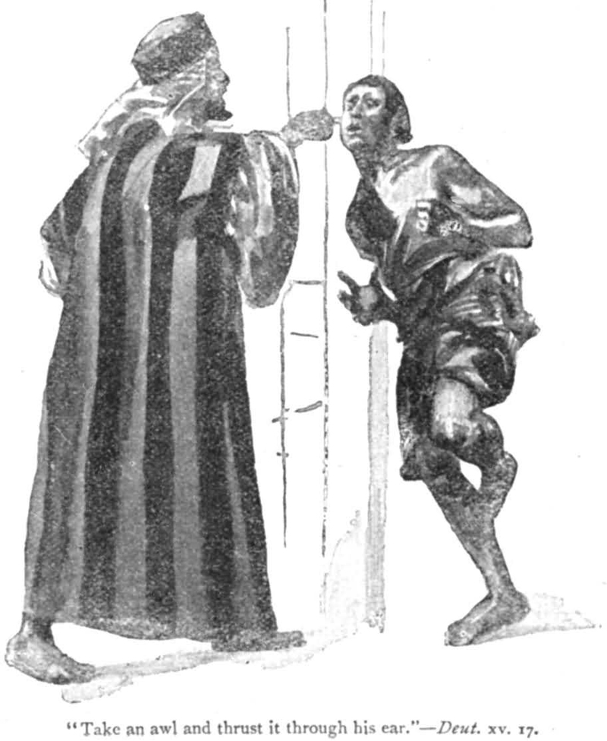
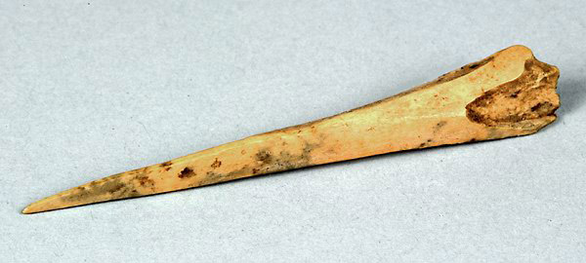
17 then take an awl and push it through his earlobe into the door, and he will become your servant for life. Do the same for your female servant.
awl
noun
a small pointed tool used for piercing holes, especially in leather

Slide 15
18 Do not consider it a hardship to set your servant free, because their service to you these six years has been worth twice as much as that of a hired hand. And the Lord your God will bless you in everything you do.

Slide 16
16 But if your servant says to you, “I do not want to leave you,” because he loves you and your family and is well off with you

Slide 17
It’s Deliberate
It’s a choice
It’s not out of a debt
It’s not out of obligation
Why verse 16?
Because he loves you
Because he loves your family

Slide 18
Psalms 100:2 - “Serve the Lord with gladness…”
II Corinthians 9:7 - so let him give; not grudgingly, or of necessity: for God loveth a cheerful giver
I Pet 5:2 - “Feed the flock of God which is among you, not by constraint, but willingly

Slide 19
John 15:15 - “I call you not servants; for the servant knoweth not what his lord doeth: but I have called you friends;

