Slide 1
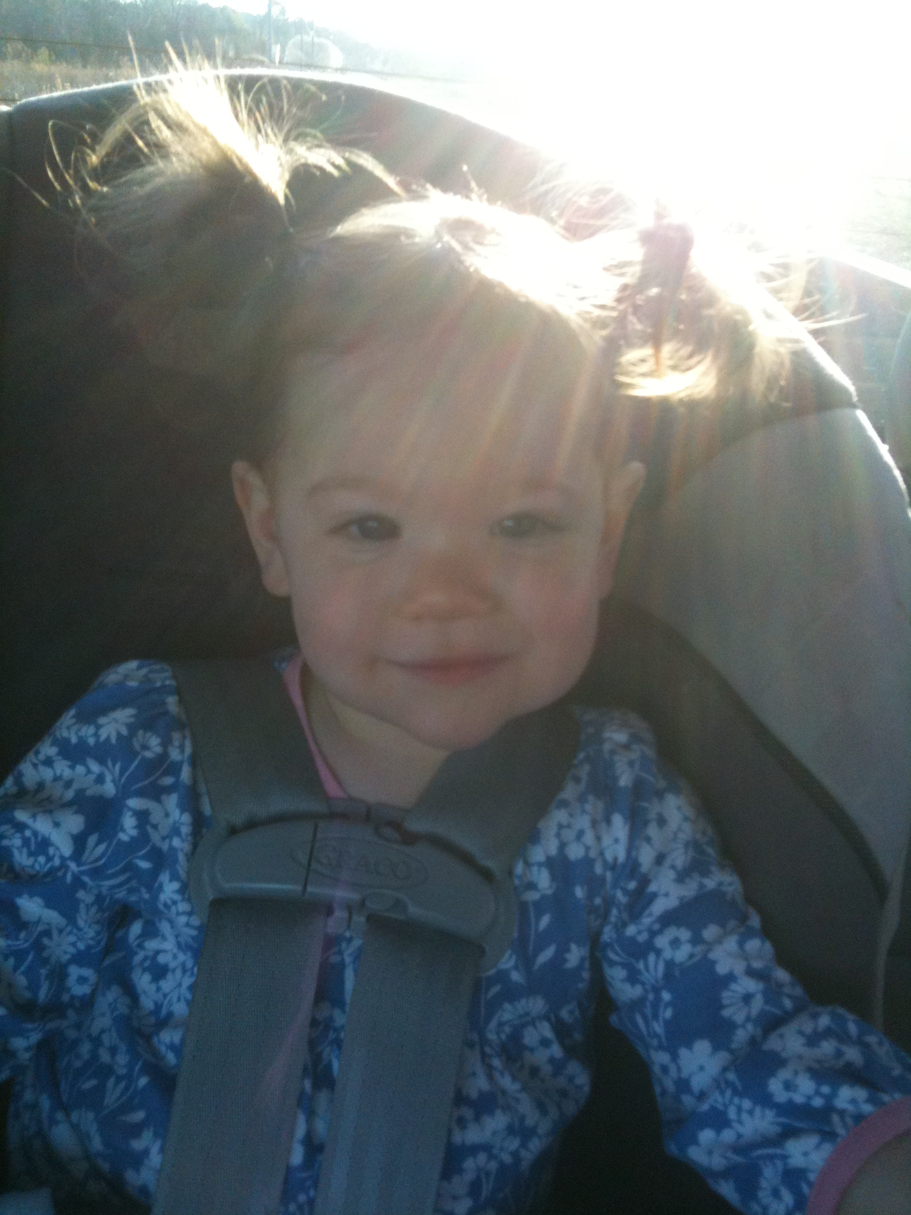
The prayer dare!

Slide 2
Pray with others!
There is more power available to us when we pray with other believers.
It's not enough to just pray with other believers.
We need to agree with them about what we are asking for – we all must be praying for the same thing.
Then, Jesus promised, our prayers are powerful.

Slide 3
Pray with others!
Matthew 18:19-20
Romans 15:30-31
Ephesians 6:19-20
2 Corinthians 1:10-11
Get over the awkwardness!!

Slide 4
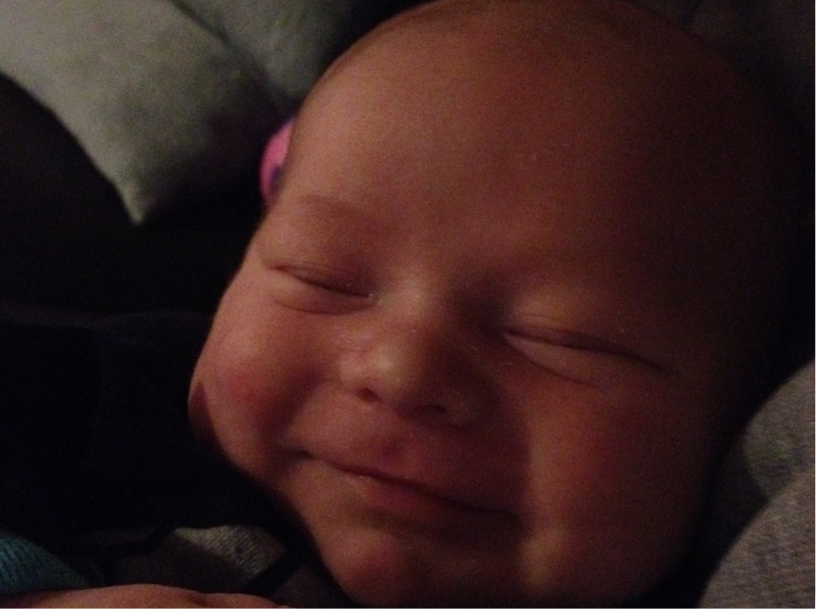

Slide 5
Pray for justice!
God notices when the government leaders are corrupt because his command apply to all people.
He doesn't have one set of rules for leaders and those in positions of power and another set of rules for common people, his statutes apply to all people.
Micah 6:8

Slide 6
Pray for Justice!
God hates compunction and injustice, not only am on theaters also people.
Isaiah 59:4
Remember to pray for God's justice, not your vengeance.
James 1:19-21

Slide 7
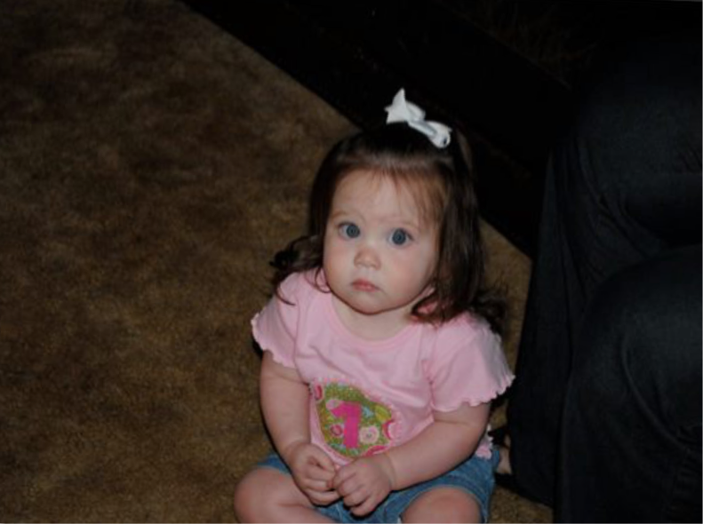

Slide 8
Pray in response to God's promptings!
How might God prompt us to pray?
His word, the Holy Spirit, people we meet, obstacles, and opportunities to become stronger... just to name a few.
1 Thessalonians 5:19
Maybe what happens to us is not just random but is God's (and the HS's) way of telling us to get to work.
Romans 8:26

