Slide 1
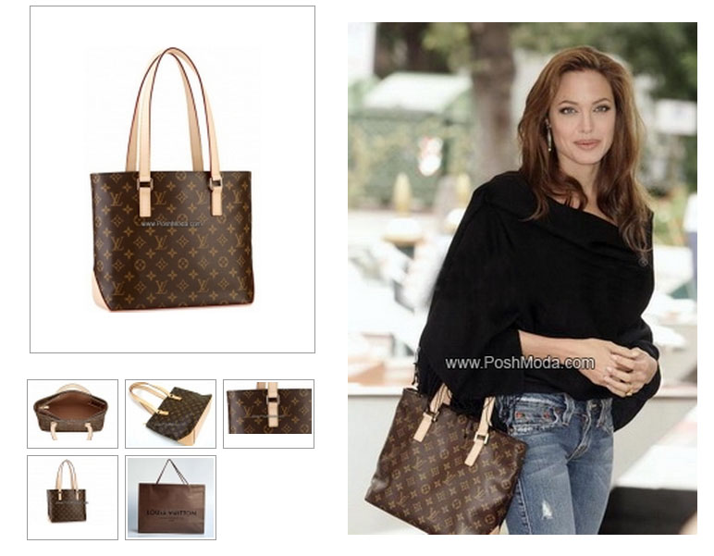
The Mo$t Lucrative Endor$ement Deal!!
Louis Vuitton- $10 Million
T-Mobile- $21.3 Million

Slide 2
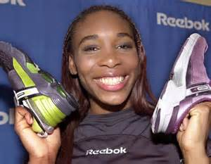
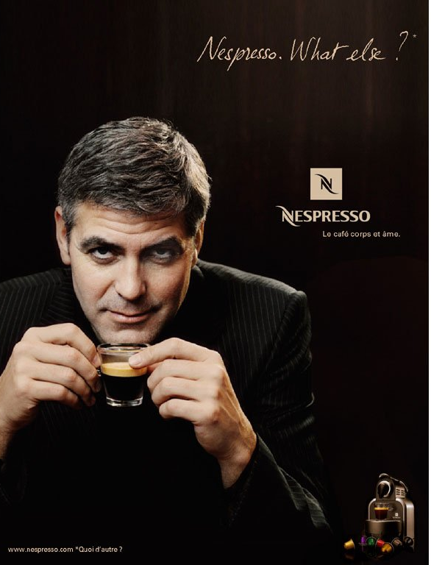
The Mo$t Lucrative Endor$ement Deal!!
Reebok- $40 Million
Nespresso- $42 Million

Slide 3
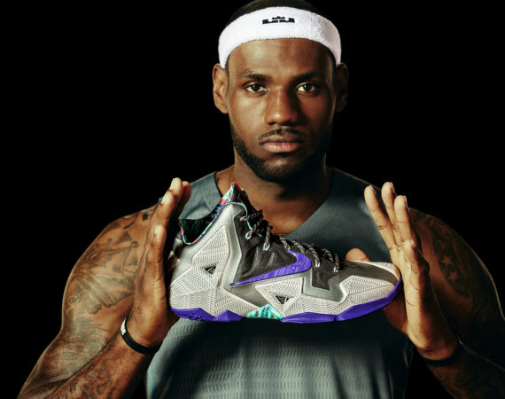
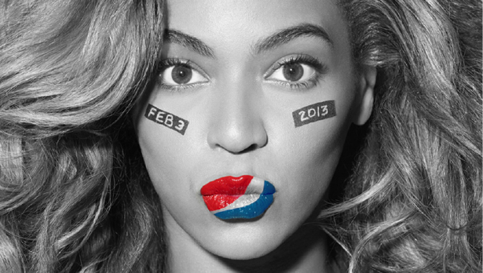
The Mo$t Lucrative Endor$ement Deal!!
Pepsi- $53 Million
Nike- $90 Million

Slide 4
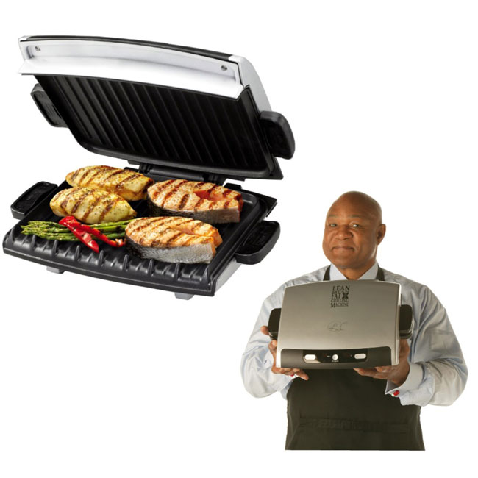
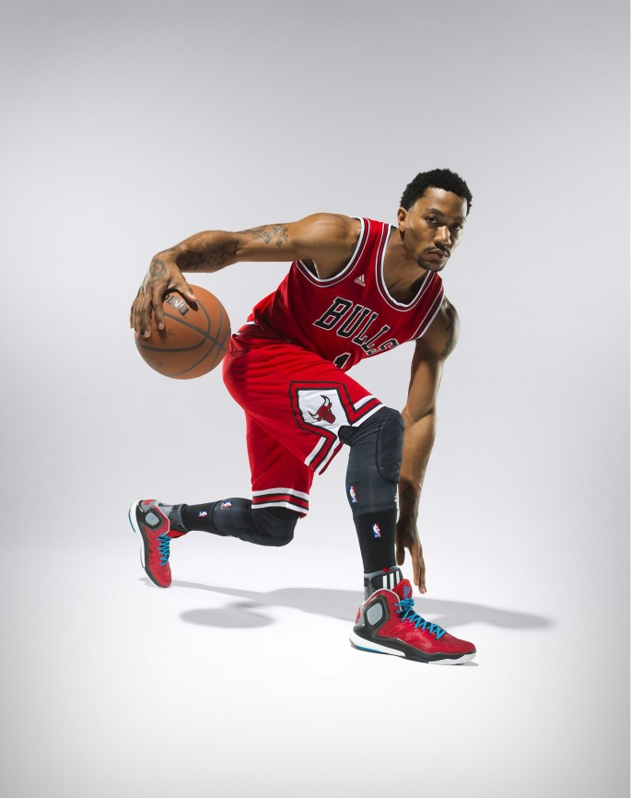
The Mo$t Lucrative Endor$ement Deal!!
Salton Inc.- $137 Million
Adidas- $260 Million

Slide 5
What do we know about endorsement deals?
Both parties get something out of it.
Endorsements can be lost!!
The most lucrative endorsement deal ever offered is to:
Christians!!!!!
Psalm 31:3
Eph. 2:8
Matt. 10:32-33

