Slide 1
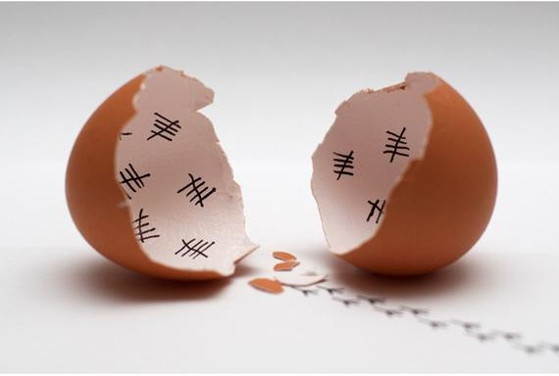
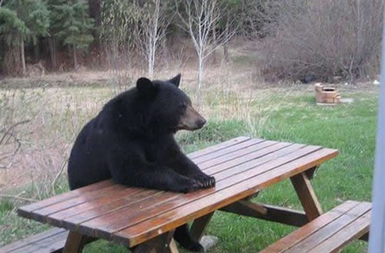

Slide 2
How to develop patience
Text: Ps. 37:1-10
Yahoo defines patient as
“bearing or enduring
pain, difficulty, provo-
cation, or annoyance
with calmness.”
Patience is a virtue.
Patience builds character and is
described as part of the Fruit
of the Spirit.

Slide 3
How to develop patience
If I want to develop patience….
TRUST IN THE LORD
Ps. 37:3,5
II Peter 1:5
Don’t fret or “calm down.”
Isaiah 30:15-16

Slide 4
How to develop patience
If I want to develop patience….
TRY TO BE GOOD
Ps. 37:3
II Peter 1:5
Virtue means “moral
excellence.”

Slide 5
How to develop patience
If I want to develop patience….
TEACH MYSELF
WHAT IS IMPORTANT
Ps. 37:4-5
II Peter 1:5-6
Knowledge

Slide 6
How to develop patience
If I want to develop patience….
TELL MYSELF “NO”
AT TIMES
Ps. 37:7
II Peter 1:6
Self-control

