Slide 1
Great Finishers

Slide 2
Great Finishers
A man caught in the
“Midian”
Ex. 39:32
Hebrews 8:5
This is the story of a man trying to find himself!!

Slide 3
Great Finishers
Started out a wine server.
Became a wall builder- Neh. 2:1
Completed in 52 days- Neh. 6:15
Rags to Riches

Slide 4
Great Finishers
Started out a persecutor- Acts 9 and 26.
Ended up a preacher, writer, and martyr- II Tim. 4:2, 6-8
Bad guy turned good

Slide 5
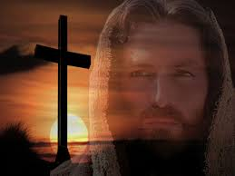
Great Finishers
John 17:4
Jn. 19:30
Hebrews
12:1-2

