Slide 1
Are all sins really that big of a deal?
Text: Psalms 1:1-2
What are some “BIG SINS?”
What are some “little sins?”
Does God ever speak of sin in terms of Big or little?
Why do we?
There are some sins that are more visible and carry with them more significant earthly consequences.

Slide 2
Are all sins really that big of a deal?
What does God say about sin?
Hebrews 11:25- “Sin is pleasurable for a season.”
I John 3:4- “Sin is lawlessness.”
Romans 6:23- “The wages of sin is death.”
Romans 8:5-8- “Sin is hostility toward God.”
Hebrews 3:13- “Sin is deceitful.”
Hebrews 3:13-15- “Sin hardens our hearts.”

Slide 3
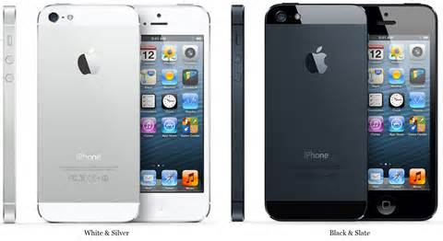
iPhone 5

Slide 4
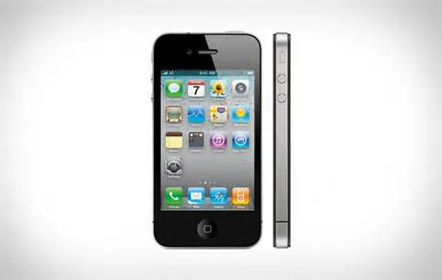
iPhone 4

Slide 5
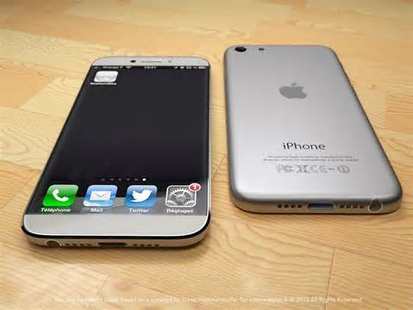
iPhone 6

Slide 6
Are all sins really that big of a deal?
Examples that illustrate that even “little sins” are a BIG DEAL!!
“Fear is the path to the dark side. Fear leads to anger. Anger leads to hate. Hate leads to suffering.”
-Yoda
Matthew 5:21-22-
Jesus really expressed this sentiment first

Slide 7
Are all sins really that big of a deal?
Examples that illustrate that even “little sins” are a BIG DEAL!!
Numbers 20:1-13
So Moses struck the rock with the his staff instead of speaking to it.
Was it really that big of a deal?
Acts 5:1-11
So Ananias and Sapphira lied a little.
Was it really that big of a deal?

Slide 8
Are all sins really that big of a deal?
Why should all sin be a big deal to me?
BECAUSE OF WHAT IT CAN DO TO ME!!!
Romans 12:1
James 1:13-15 and Psalm 1:1-2
BECAUSE OF WHAT IT MEANS TO GOD!!!!
Isaiah 53
Romans 8:5-8

