Slide 1
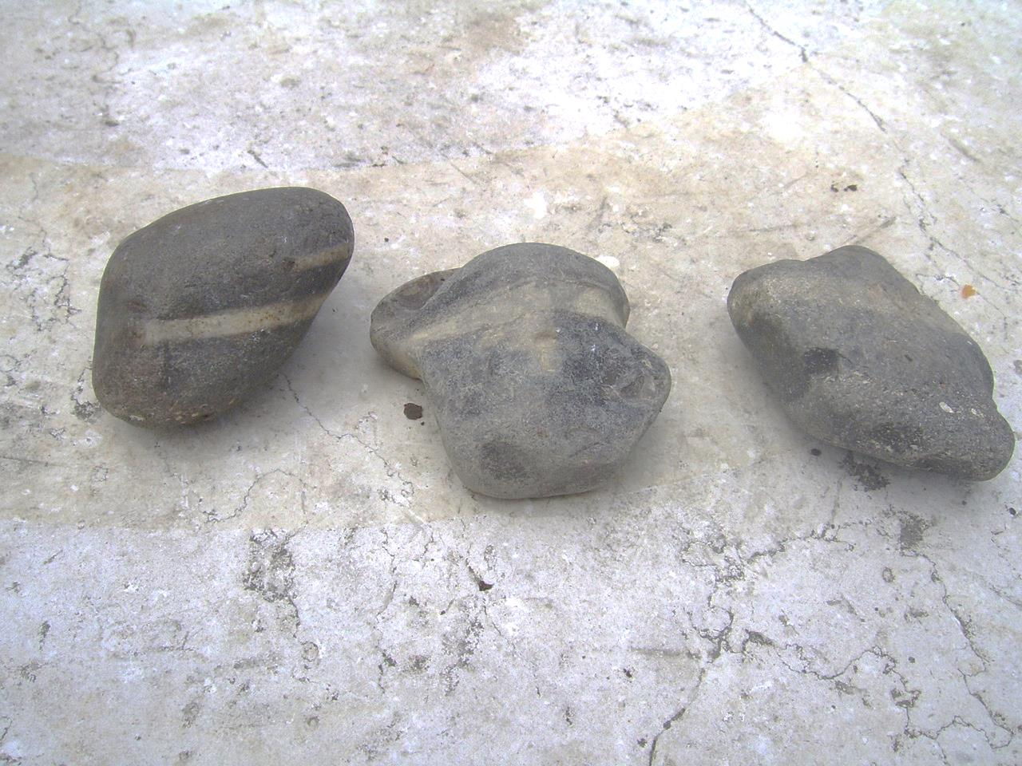
Don’t throw Rocks
Text: John 8:2-11
If you put a rock in front of a kid, well you know what comes next.
So we have to tell our kids what should be obvious. DON’T THROW ROCKS!!!!
Apparently, this is not exclusive to children.

Slide 3
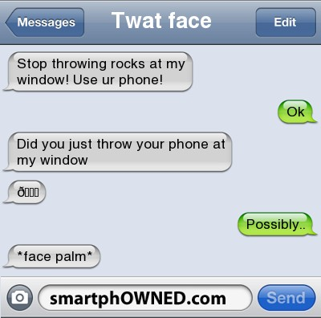

Slide 4
Don’t throw Rocks
Jesus had to tell some adults not to throw rocks in John 8.
What this story does not teach:
That judging sin is wrong!
That sin is excused!
That continuing in sin is alright!

Slide 5
Don’t throw Rocks
This story teaches us about:
Self-examination
Lesson on will the real Pharisees please stand up.
Matt. 5:3-10
Forgiveness
God’s expectations

