Slide 1
LORD, HOLD MY HAND Isaiah 41:13

Slide 2
Daddy, hold my hand…
When we think about holding hands, it can conjure up a lot feelings and emotions.
Holding hands shows affection, friendship, love, protection, and support among other feelings.
When my girls were little, I loved to hold their hands. It was a special thing between us & made it very real to me that I was their protector.

Slide 3
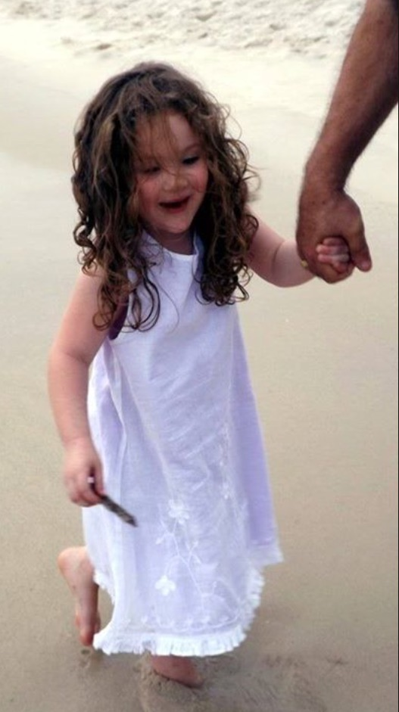
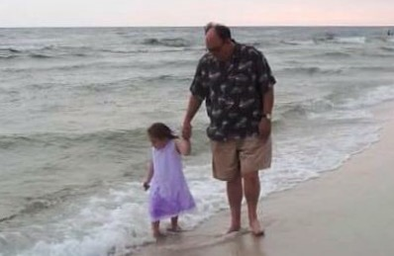

Slide 4
Lord, hold my hand…
When I am scared. Deuteronomy 31:6
Sadly, those moments of holding Emma’s & Anna’s hands are gone far to quickly. They don’t need me to protect them in a parking lot or crossing the street anymore.
Spiritually speaking, I’m scared a lot. I’m scared I’m inadequate. I’m scared I don’t do enough for the Lord. I’m scared I’ve missed opportunities.
God wants to hold my hand through it all. And He will if I will reach out and take His hand.

Slide 5
Lord, hold my hand…
When I doubt You and Your power.
How perfectly does that lead us to Matthew 14:30-33?
When I am sinking, do I have the sense to reach and grab the savior’s outstretched hand?
When others I know experience doubt, do I direct them to that same outstretched hand? Mark 2:1-5
Like fear, doubt can come in many forms. Doubt in my self worth, doubting God’s promises, & doubt in the local Church.
We must not let Satan fill us with doubt. John 8:44

Slide 6
Lord, hold my hand…
When I am hurt and upset.
When our children are young and they fall we often use the phrase “do you want me to kiss it and make it better?”
When we make the spiritual application, that is exactly what God and Christ want for us. They want to take away our pain.
Psalm 34:15-22
God knows our sadness and our heartache.
He longs to hold our hands through the difficult times to demonstrate how much He loves us and cares for us.

Slide 7
Lord, hold my…
When I am wrong.
Sometimes we need someone to hold our hands when we’re having a hard time making choices. “do I need to come hold your hand?”
When the girls were young, I would often hold their hands if they had not listened or obeyed Mom and Dad.
Are we, as more mature Christians, that different? Do we act like we don’t need Jesus to guide us through our wrong?
1 John 1:19; Proverbs 28:13; Colossians 3:12-15

Slide 8
Lord, hold my hand…
ALL THE TIME
Psalm 73:23-28

