Slide 1
“Exhort one another while it is today…” Hebrews 3:13

Slide 2
Exhort – to Strongly encourage or urge (someone) to do something.

Slide 3
Insist
Plead
Press
Pressure
Prompt
Stir
Stimulate
Spur
Admonish
Advise
Beseech
Call upon
Caution
Encourage
Enjoin
Insist
Incite
Persuade
Preach
Prod
Bid
Counsel
Entreat
Goad

Slide 4
Insist
Plead
Press
Pressure
Prompt
Stir
Stimulate
Spur
Admonish
Advise
Beseech
Call upon
Caution
Encourage
Enjoin
Insist
Incite
Persuade
Preach
Prod
Bid
Counsel
Entreat
Goad

Slide 5
But exhort one another every day, as long as it is called “today,” that none of you may be hardened by the deceitfulness of sin. Hebrews 3:13

Slide 6
Why might a Christian do these things to other people?

Slide 7
1. To change a person’s spiritual trajectory.

Slide 8
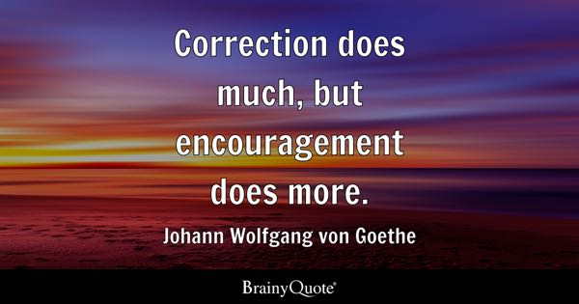

Slide 9
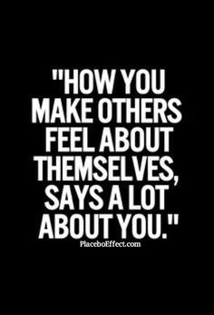
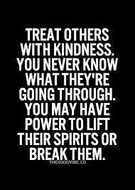
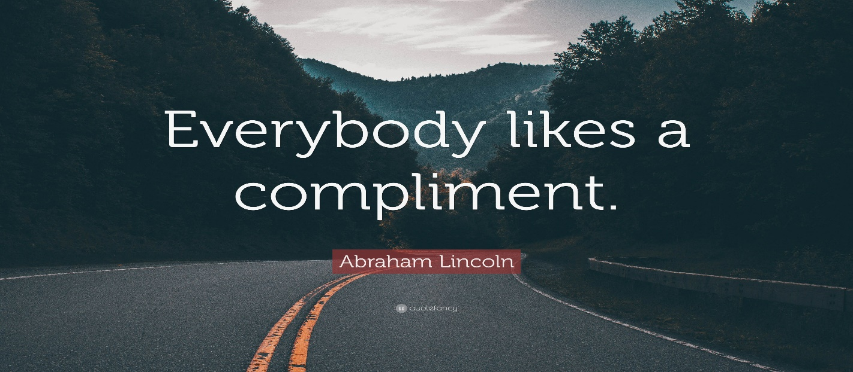

Slide 10
Most of us, swimming against the tides of trouble the world knows nothing about, need only a bit of praise or encouragement - and we will make the goal. – Robert Collier

Slide 11
Surely, if we knew that something we could say or do would change someone’s eternal destination we would not hesitate to act.
Some people need more encouragement & exhortation that others.
Building each other up is supposed to give us hope. If there is anything this world could use more of, it’s hope. Romans 15:1-7

Slide 12
If your words or actions could cause someone to go from feeling HOPELESS to feeling HOPEFUL, what what kind of tragedies & heartache could you potentially save them from?

Slide 13
Many of you might be like many other Christians I know who don’t know how to give encouragement & exhortation. That’s okay.
Wanting to get better at something is a much better position than remaining stagnant.
Philippians 4:8-9 gives us a great template.
Are you willing to put in the work?

Slide 14
“Our prayers should be thrown across the pathway of men & women as they rush in their downward course to a lost eternity”

Slide 15
2. It reflects an attitude of thankfulness & forgiveness.

Slide 16
Hopefully you recognize the many things that Christians have to be thankful for. Do we truly “Count our many blessings?”
Matthew 18:21-35 – Let’s not be guilty of scoffing at the unforgiving servant.
How encouraging & uplifting will it be to someone when they receive your forgiveness.
We exhort because we’ve been exhorted.

Slide 17
Let’s not just be content to receive compliments, encouragement, or counsel.
We should always be looking for ways we can bless someone with our words or actions.
In turn, we can be thankful when God uses someone to say or do something kind or helpful to encourage our hearts. Be the one in Luke 17.

Slide 18
3. It gives people (Christians & Non-Christians) confidence they desperately need.

Slide 19
Many people are hampered by lack of confidence. It keeps them from doing so much.
Have you ever considered the situation that Joshua found himself in? Deuteronomy 31.
When I think of strong Old Testament leaders, Moses rises to the top quickly.
Can you imagine following him? Look at how Moses encourages & strengthens Joshua.

Slide 20
4. It causes the Church to grow.

Slide 21
All of us have probably heard some interesting sermon titles. Here is one I remember very vividly: “How to kill a church.”
We may not realize that our lack of exhortation & encouragement could be something that harms the Church. Yet it happens quite often.
Acts 11:21-26 – The son of encouragement.

Slide 22
I wonder how far reaching all that encourage-ment from Barnabas went. How many people that he exhorted went on to do the same?
God uses others to encourage us, and God wants to use us to encourage others.
What a great cycle of growth. Matthew 7:12
Your past experiences make you the perfect encourager & admonisher. James 1: 2-4

Slide 23
People (usually) want to be around nice people. That could be the very thing that first brings them to thinking about spiritual things. John 4:39-42. What first brought the people to Jesus (Church)?

Slide 24
5. Tomorrow isn’t guaranteed

Slide 25
Hebrews 3:14 – While it is today.
First, you’re not guaranteed tomorrow to be able to give that encouragement or build someone up. The Lord may call you home.
Secondly & more importantly, they aren't guaranteed tomorrow.
What if your encouragement was what put them on the path to knowing Christ & heaven?

Slide 26
Don’t wait to say or do that thing of encouragement or exhortation. James 4:13-17
How many times have you tragically heard of someone who left the house and never made it back home? Say that encouraging thing!!!
Not to mention that we don’t know when Christ might return – “As a thief in the night” – 1 Thessalonians 5:1-11

Slide 27
Don’t wait to do things that could have eternal importance for you and others. Wake up and do it today! Romans 13:8-14

Slide 28
Why should a Christian exhort & encourage other people?

Slide 29
1. It could change someone’s trajectory.
2. It reflects an attitude of thankfulness & forgiveness.
It gives people confidence they desperately need.
4. It causes the Church to grow.
5. Tomorrow isn’t guaranteed.

