Slide 1
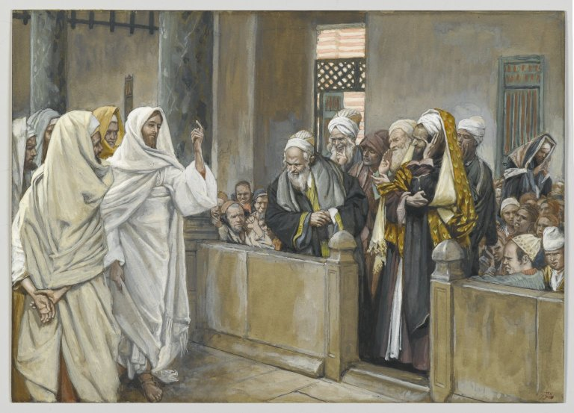
TELL IT LIKE IT IS TUESDAY
Part 1b
MATTHEW 23

Slide 2
TELL IT LIKE IT IS TUESDAY
Part 1b
Prior to chapter 23, Jesus has been addressing questions from the religious leaders and telling parables directed at the scribes, Pharisees and Sadducees.
But, when we get to chapter 23, Jesus takes direct aim and unloads on his opponents.
Their hypocrisy is exposed!!!

Slide 3
TELL IT LIKE IT IS TUESDAY
Part 1b
Articulation, Avoidance and Arrogance
  Matt. 23:1-12 is Jesus warning the crowds and the disciples about the scribes and Pharisees, unveiling their hypocrisy.
  Matt. 23:13-36 is a section explicitly directed to these abusers of God’s religious expectations. Jesus pronounces 7 Woes on these spiritually corrupt religious figures.

Slide 4
TELL IT LIKE IT IS TUESDAY
Part 1b
Identifying the woes:
  Woe #1- Shutting the kingdom to the people.
    These teachers of the law are false leaders. They have lead the people away from God rather than towards Him!
    They were doing everything in their power to dissuade any belief in Jesus as the Messiah.
    If you don’t have Jesus, you not in the kingdom.

Slide 5
TELL IT LIKE IT IS TUESDAY
Part 1b
Identifying the woes:
  Woe #2- Mislead Converts.
    Jesus is not here condemning the practice of evangelizing or making disciples.
    But you better be careful about what you use to make disciples.
    They would elevate their traditions to level commandments from God.

Slide 6
TELL IT LIKE IT IS TUESDAY
Part 1b
Identifying the woes:
  Woe #3- Swearing and dishonesty.
    Apparently, there were promises that could be broken!
    How much trust could you really have in these people?
    Jesus tells us to simply say “yes” or “no” according to Matt. 5:37.

Slide 7
TELL IT LIKE IT IS TUESDAY
Part 1b-2
Identifying the woes:
  Woe #4- Devouring widow’s houses.
    They would take advantage of the confidence placed in them by widows.
      It may have been that as lawyers, they served as executors of their property and possibly would take possession of these assets.
      Josephus alludes to the influence these men had over the widows.

Slide 8
TELL IT LIKE IT IS TUESDAY
Part 1b-2
Identifying the woes:
  Woe #4- Omitting weightier matters.
    Jesus doesn’t care about your doctrine or your worship practices if you focus only on these and forget to love.
    Paul confirms as much in I Cor. 13:1ff.
    Do we think that we can appease God by honoring the things that he is least concerned about?

Slide 9
TELL IT LIKE IT IS TUESDAY
Part 1b-2
Identifying the woes:
  Woes #5, #6- Outward perceptions versus internal realities.
    They looked good outwardly but they were rotten to the core.
  Woe #7- Oblivious to repetitive behaviors.
    They were doing the same things that their fathers had been guilty of.

