Slide 1
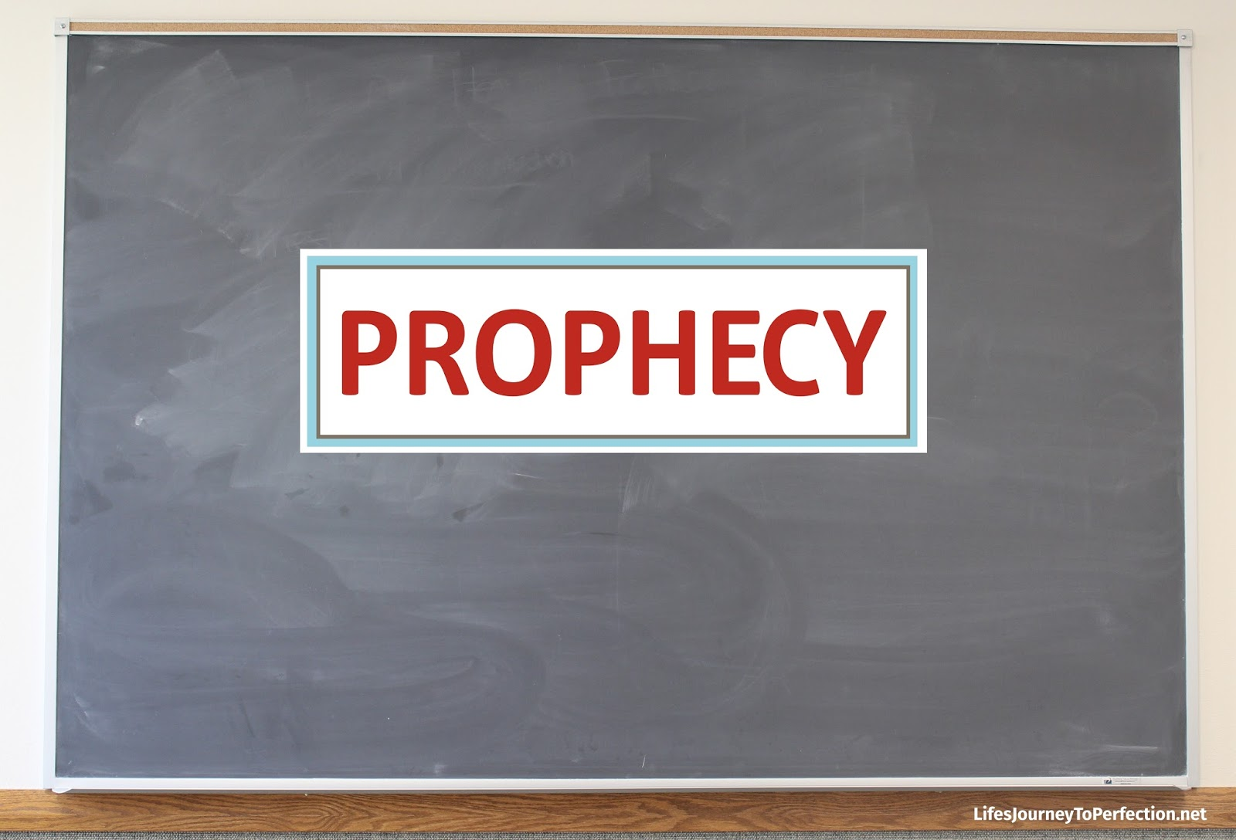

Slide 2
Text: II Peter 1:19-21
“And we have the prophetic word more fully confirmed, to which you will do well to pay attention as to a lamp shining in a dark place, until the day dawns and the morning star rises in your hearts, knowing this first of all, that no prophecy of Scripture comes from someone’s own interpretation. For no prophecy was ever produced by the will of man, but men spoke from God as they were carried along by the Holy Spirit.”

Slide 3
Prophecy defined:
Greek word “propheteia.”
pro-, “forth,” phemi-, “to speak.”
Means prediction. (Strong’s Exhaustive Con.)
Signifies “the speaking forth of the mind and counsel of God.” (Vines Expository Dict.)
Formerly, prophecy was revealed in a supernatural way which has now passed away (I Cor. 13:8). However, today we can teach what was prophesied through what is revealed in the Bible.

Slide 4
:
HELPS GROUND OUR FAITH
The confirmation of prophecy fortifies our belief in God and His Word.
Fulfilled prophecies in the Bible:
Historical prophecies- Cyrus- Is. 44:28, Church- Dan. 2:44.
Messianic prophecies- Birth-Micah 5:2, Death- Is. 53

Slide 5
HELPS GUIDE OUR FAITH
Pay attention because it is a lamp shining in a dark place. Prophecy helped enlighten what was to come.
Lamps give forth light to illuminate the way.
New Covenant described- Jeremiah 31:31-34, (Heb. 8:8-12)
II Timothy 3:16

Slide 6
HELPS GUARD OUR FAITH
If we continue to rely on the prophetic word then we will be protected against falling.
The realization of the truths concerning prophecy should sustain us and keep us faithful. Also, the experience of the prophetic word.
II Peter 1:3-11
Peter uses terminology such as “you will never fall” and “there will be richly provided for you an entrance into the eternal kingdom.”

