Slide 1
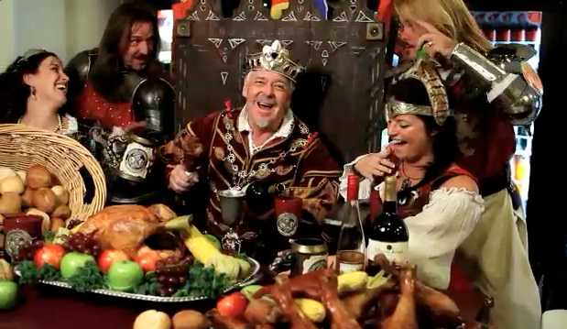
Living Like Kings

Slide 2
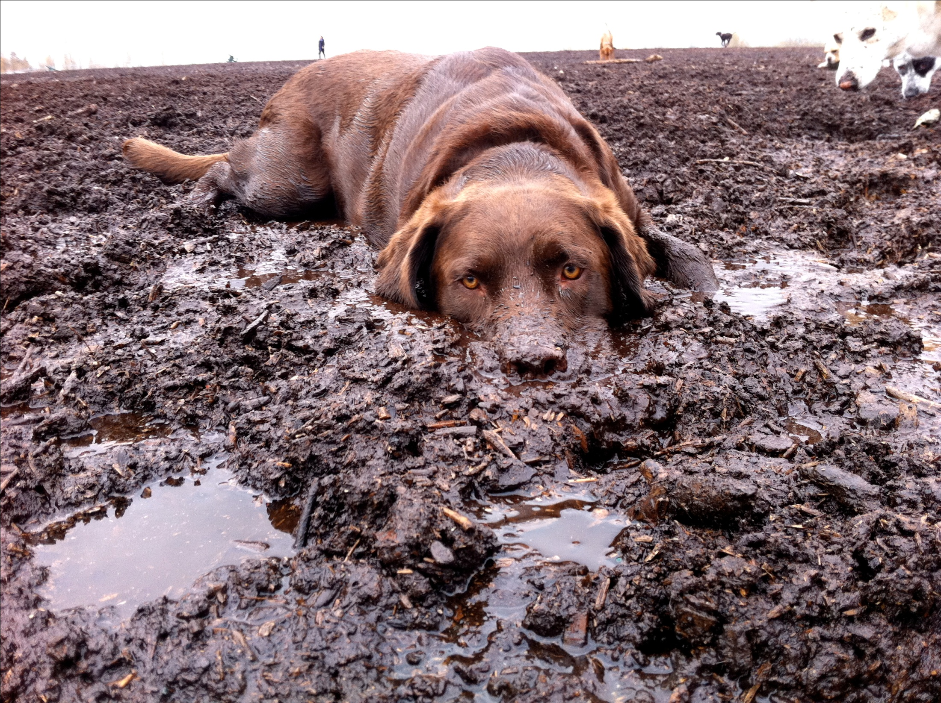
You Smell Like a Dog

Slide 3
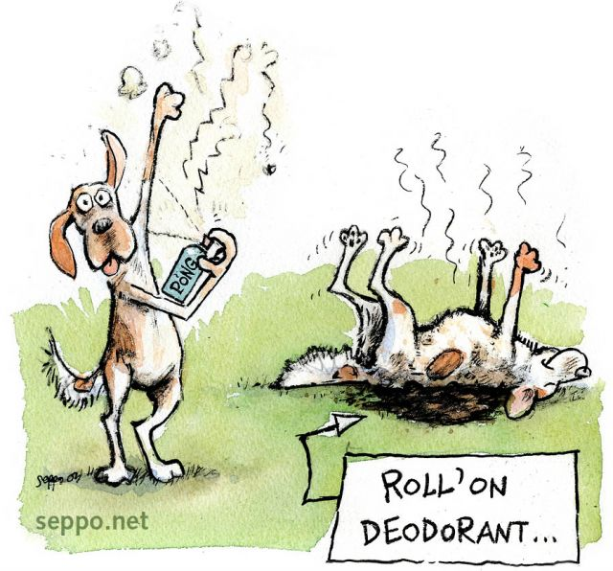

Slide 4
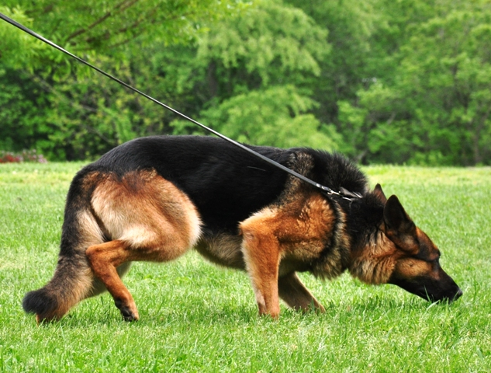

Slide 5
2 Chronicles 15
2Ch 15:1 ¶ Now the Spirit of God came upon Azariah the son of Oded.
2 And he went out to meet Asa, and said to him: "Hear me, Asa, and all Judah and Benjamin. The LORD is with you while you are with Him. If you seek Him, He will be found by you; but if you forsake Him, He will forsake you.
3 "For a long time Israel has been without the true God, without a teaching priest, and without law;
4 "but when in their trouble they turned to the LORD God of Israel, and sought Him, He was found by them.

Slide 6
2 Chronicles 15
Now the Spirit of God came upon Azariah the son of Oded.
2 And he went out to meet Asa, and said to him: "Hear me, Asa, and all Judah and Benjamin. The LORD is with you while you are with Him. If you seek Him, He will be found by you; but if you forsake Him, He will forsake you.

Slide 7
2 Chronicles 15
3 "For a long time Israel has been without the true God, without a teaching priest, and without law;
4 "but when in their trouble they turned to the LORD God of Israel, and sought Him, He was found by them.

Slide 8
2 Chronicles 15
5 "And in those times there was no peace to the one who went out, nor to the one who came in, but great turmoil was on all the inhabitants of the lands. ⁶ "So nation was destroyed by nation, and city by city, for God troubled them with every adversity. ⁷ "But you, be strong and do not let your hands be weak, for your work shall be rewarded!"

Slide 9
2 Chronicles 15
8 And when Asa heard these words and the prophecy of Oded the prophet, he took courage, and removed the abominable idols from all the land of Judah and Benjamin and from the cities which he had taken in the mountains of Ephraim; and he restored the altar of the LORD that was before the vestibule of the LORD.

Slide 10
2 Chronicles 15
8 And when Asa heard these words and the prophecy of Oded the prophet, he took courage, and removed the abominable idols from all the land of Judah and Benjamin and from the cities which he had taken in the mountains of Ephraim; and he restored the altar of the LORD that was before the vestibule of the LORD.

Slide 11
2 Chronicles 15
9 Then he gathered all Judah and Benjamin, and those who dwelt with them from Ephraim, Manasseh, and Simeon, for they came over to him in great numbers from Israel when they saw that the LORD his God was with him.

Slide 12
2 Chronicles 15
12 Then they entered into a covenant to seek the LORD God of their fathers with all their heart and with all their soul;
15 And all Judah rejoiced at the oath, for they had sworn with all their heart and sought Him with all their soul; and He was found by them, and the LORD gave them rest all around.

Slide 13
2 Chronicles 15
17 But the high places were not removed from Israel. Nevertheless the heart of Asa was loyal all his days.

Slide 14
2 Chronicles 16
1 In the thirty-sixth year of the reign of Asa, Baasha king of Israel came up against Judah and built Ramah, that he might let none go out or come in to Asa king of Judah.

Slide 15
2 Chronicles 16
2 Then Asa brought silver and gold from the treasuries of the house of the LORD and of the king's house, and sent to Ben-Hadad king of Syria… saying, ³ "Let there be a treaty between you and me, as there was between my father and your father. Here, I have sent you silver and gold; come, break your treaty with Baasha king of Israel, so that he will withdraw from me."

Slide 16
2 Chronicles 16
7 And at that time Hanani the seer came to Asa king of Judah, and said to him: "Because you have relied on the king of Syria, and have not relied on the LORD your God, therefore the army of the king of Syria has escaped from your hand. ⁸ "Were the Ethiopians and the Lubim not a huge army with very many chariots and horsemen?

Slide 17
2 Chronicles 16
8b Yet, because you relied on the LORD, He delivered them into your hand. ⁹ For the eyes of the LORD run to and fro throughout the whole earth, to show Himself strong on behalf of those whose heart is loyal to Him. In this you have done foolishly; therefore from now on you shall have wars."

Slide 18
2 Chronicles 16
10 Then Asa was angry with the seer, and put him in prison, for he was enraged at him because of this. And Asa oppressed some of the people at that time.

Slide 19
2 Chronicles 16
12 And in the thirty-ninth year of his reign, Asa became diseased in his feet, and his malady was severe; yet in his disease he did not seek the LORD, but the physicians.
¹³ So Asa rested with his fathers; he died in the forty-first year of his reign.

Slide 20
Are You Living Like King Asa?
DO YOU HAVE A LOYAL, BUT FAITHLESS,
HEART?

Slide 21
2 Chronicles 17
1 ¶ Then Jehoshaphat his [Asa’s] son reigned in his place, and strengthened himself against Israel.
3 Now the LORD was with Jehoshaphat, because he walked in the former ways of his father David; he did not seek the Baals, ⁴ but sought the God of his father, and walked in His commandments and not according to the acts of Israel.

Slide 22
2 Chronicles 17
6 And his heart took delight in the ways of the LORD;
8 …he sent Levites… and with them… the priests. ⁹ So they taught in Judah, and had the Book of the Law of the LORD with them; they went throughout all the cities of Judah and taught the people.

Slide 23
2 Chronicles 18
1 Jehoshaphat had riches and honor in abundance; and by marriage he allied himself with Ahab.

Slide 24
2 Chronicles 19
2And Jehu the son of Hanani the seer went out to meet him, and said to King Jehoshaphat, "Should you help the wicked and love those who hate the LORD? Therefore the wrath of the LORD is upon you. ³ Nevertheless good things are found in you, in that you have removed the wooden images from the land, and have prepared your heart to seek God."

Slide 25
2 Chronicles 20
1 It happened after this that the people of Moab with the people of Ammon, and others with them besides the Ammonites, came to battle against Jehoshaphat.
3 And Jehoshaphat feared, and set himself to seek the LORD, and proclaimed a fast throughout all Judah.

Slide 26
2 Chronicles 20
14 Then the Spirit of the LORD came upon Jahaziel…
15 And he said, "Listen, all you of Judah and you inhabitants of Jerusalem, and you, King Jehoshaphat! Thus says the LORD to you: 'Do not be afraid nor dismayed because of this great multitude, for the battle is not yours, but God's.

Slide 27
2 Chronicles 20
16 'Tomorrow go down against them. They will surely come up by the Ascent of Ziz, and you will find them at the end of the brook before the Wilderness of Jeruel. ¹⁷ You will not need to fight in this battle. Position yourselves, stand still and see the salvation of the LORD,… O Judah and Jerusalem!' Do not fear or be dismayed; tomorrow go out against them, for the LORD is with you."

Slide 28
2 Chonicles 20
20 So they rose early in the morning and went out into the Wilderness of Tekoa; and as they went out, Jehoshaphat stood and said, "Hear me, O Judah and you inhabitants of Jerusalem: Believe in the LORD your God, and you shall be established; believe His prophets, and you shall prosper."

Slide 29
2 Chronicles 20
24 So when Judah came to a place overlooking the wilderness, they looked toward the multitude; and there were their dead bodies, fallen on the earth. No one had escaped.

Slide 30
2 Chronicles 20
24 So when Judah came to a place overlooking the wilderness, they looked toward the multitude; and there were their dead bodies, fallen on the earth. No one had escaped.

Slide 31
2 Chronicles 20
26 And on the fourth day they assembled in the Valley of Berachah [Blessing], for there they blessed the LORD; therefore the name of that place was called The Valley of Berachah until this day.

Slide 32
Are You Living Like King Jehoshaphat?
Taking delight in the ways of the Lord,
Teaching God’s word,
Trusting God completely.

Slide 33
The Bible Says…
2Ch 20:32 And he [Jehoshaphat] walked in the way of his father Asa, and did not turn aside from it, doing what was right in the sight of the LORD.

Slide 34
BUT!!!
Isn’t there something inside you that longs to be more like Jehoshaphat than Asa?
A heart loyal to God is GREAT!
But don’t you want one that fully trusts God, as well? (cf. Mark 9:24)

