Slide 2
The Great Commission
Matt. 28:18-20 – Make disciples
Mark 16:15-16 – Preach
Luke 24:46-48 – Be witnesses
John 20:21-23 – Offer forgiveness
Acts 1:8 – Be witnesses

Slide 3
What makes the Great Commission so Great?
Explicit Commands
New Testament > Old Testament
Jesus!
Their Placement suggests their strategic importance

Slide 4
Matthew 28:16-20
Gathered near the end of Jesus time on earth—significant moment
Vs. 18—based on the authority of Jesus
Daniel 7:13-14
We don’t go to conquer…we go in the name of the one who has already conquered.

Slide 5
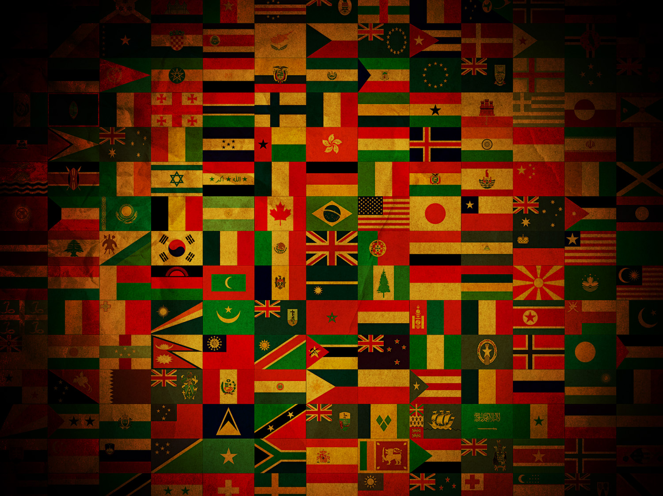
All Nations

Slide 6
Matthew 28:18-20
Vs. 20—Jesus isn’t just sending us, he is going with us!

Slide 8
John 20:21
The sent one becomes the sender.
Their mission proceeds from Jesus’ mission. They are sent because he has completed his mission.
Jesus being sent is the foundation for our sending.
Jesus’ mission was a spiritual one.

Slide 10
Mark 16:15
Go into all the world…
Gospel
What is the gospel (1 Cor. 15:4)?
Noun: euaggelion = “good news” or “glad tidings,” often translated “gospel.”
Verb: euaggelizomai = to “proclaim good news” or “announce glad tidings.”

Slide 11
Luke 24:44-47
Vs. 44 the authority of Jesus is rooted in the Scripture.
Vs. 45 When he opens their mind to Scriptures, he points to what the Mission of God entails—Jesus and his message being proclaimed to the whole world!

Slide 12
Luke 24:44-47
Vs. 46
Centrality of the gospel
3 verbs: suffer, rise, and be proclaimed
Vs. 47
Repentance and forgiveness of sins

Slide 13
Acts 1:8
Serves as an outline to Acts:
The Church Established at Jerusalem (Ch. 1-7)
The Church Enlarged to Judea and Samaria (Ch. 8-12)
The Church Expanded to the Ends of the Earth (Ch. 13-28)

Slide 14
Acts 1:8
Witnesses
Eyewitness—one who can testify about what he had seen or heard (Acts 4:19).

Slide 15
His last command should be our first concern.
The church that lives for itself will die by itself.

Slide 16
32%
World “Christian”
Population

Slide 17
1/3
of
World’s Population
has never heard the basics of the Gospel

Slide 19
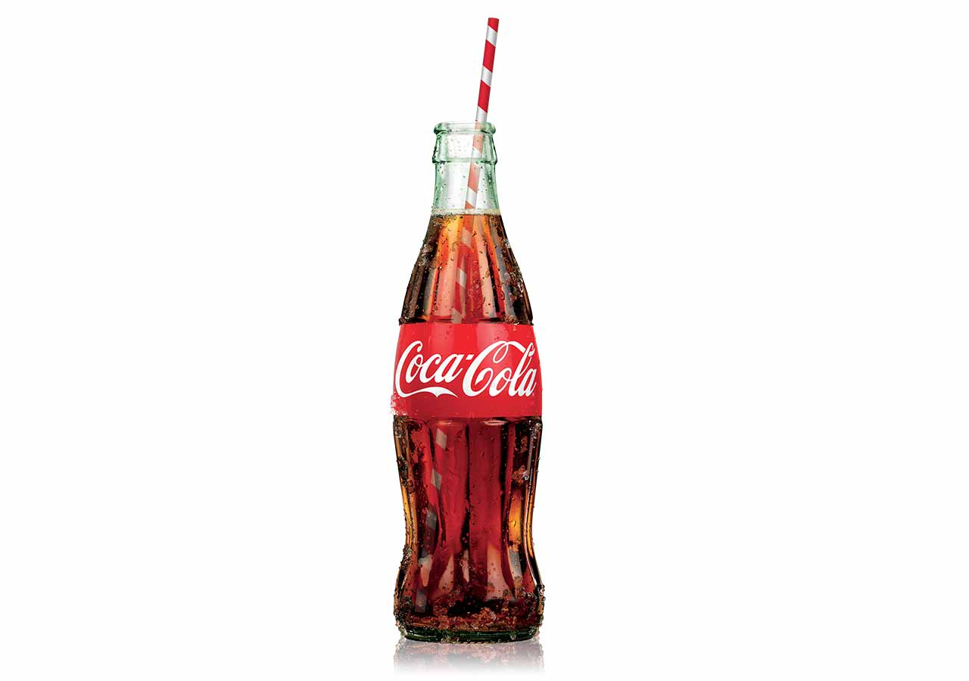
94% of the world’s population recognize the Coca-Cola symbol.
The world has been reached in 119 years for profit’s sake.

