Slide 1
T.B. Larimore
“From Maine to Mexico and from Canada to Cuba.”

Slide 2
Theophilus Brown Larimore 1843-1929

Slide 3
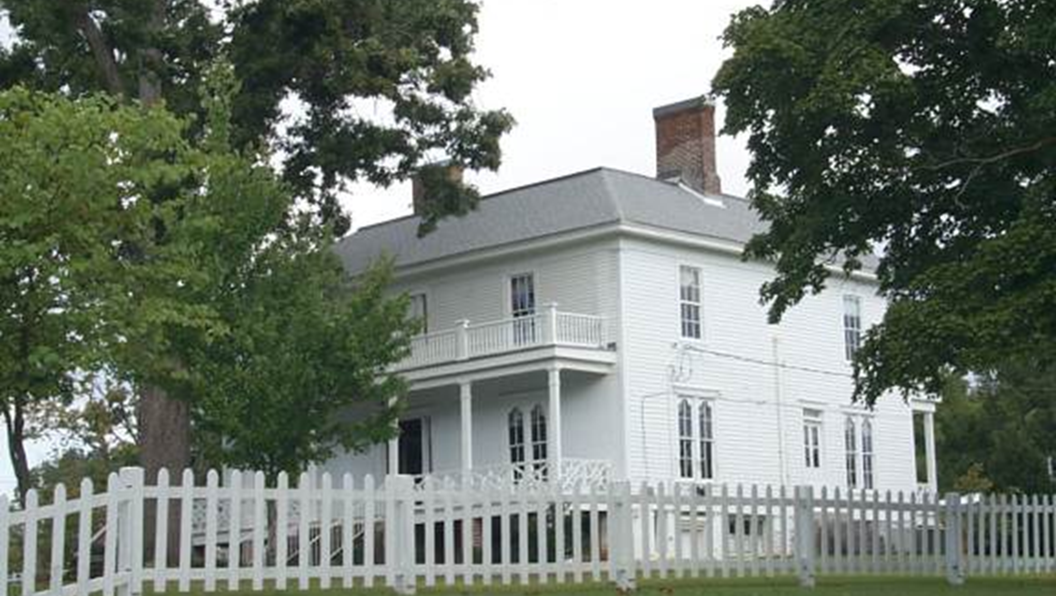

Slide 4
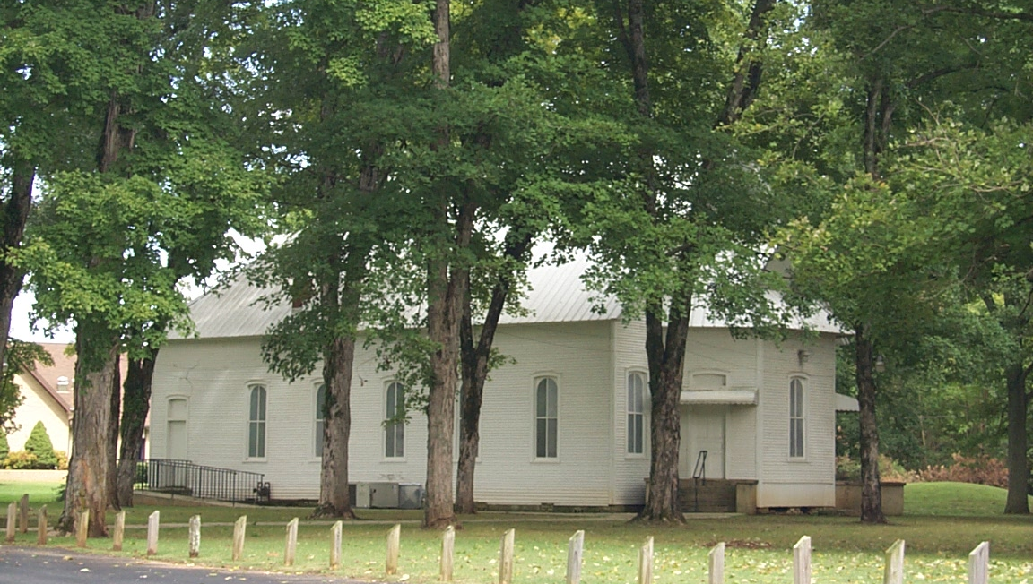

Slide 5
T.B. Larimore
Background
Grew up very poor in Tennessee.
Worked on a farm
Was only able to attend school 10-12 weeks a year but study in the evenings throughout the entire year.
At 16 he decided to attend the Mossy Creek Baptist College in East Tennessee.
He fought in the Civil War with the Confederacy.
Obeyed the Gospel on his 21st birthday in 1866.
Began preaching later that year.

Slide 6
T.B. Larimore
His Nature was:
Sacrificial and Industrious
Humble and Pious
Kind and Gentle
It was not his style or disposition to engage in controversy or to be offensive in his preaching.

Slide 7
T.B. Larimore
His Nature was:
To Preach the Gospel
Eloquent speaker.
Preached with earnestness and clearness.
Preached a lot.

