Slide 1
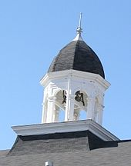
N.B. Hardeman
Educator, Preacher, Debater

Slide 3
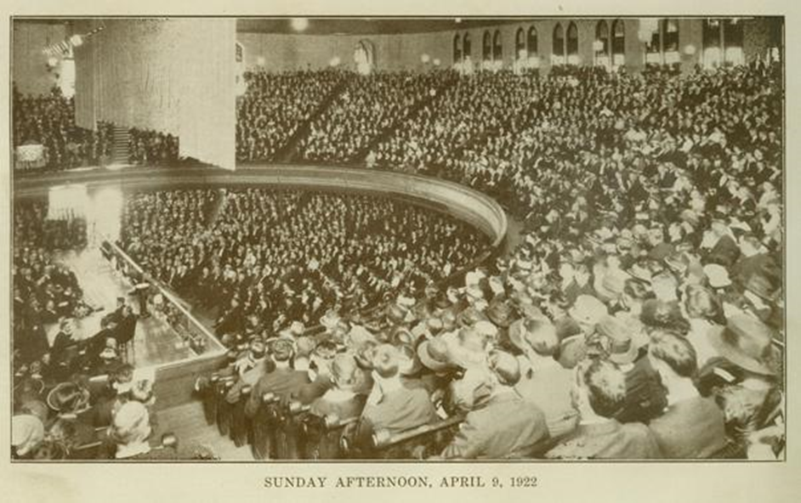

Slide 4
N.B. Hardeman
Conversion
Disgusted by the fanatical emotionalism of his families’ religion.
Two preachers appealed to the word of God
J.A. Minton
J.L. Haddock
85th Birthday Party
Peabody Hotel in Memphis
Distinguished guests

Slide 5
N.B. Hardeman
Educational Contributions
Teacher
College Founder
College President
Evangelical Contributions
Tabernacle Sermons
Ecumenical Contributions (Tending toward world-wide Christian unity)
Debater

