Slide 1
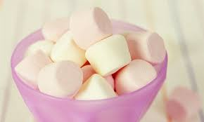
DELAYED GRATIFICATION “The Blessing of Self-Control”
Text: II Cor. 4:17
I believe the essence of the Christian life can be found in this passage.
The scripture has much to say about the importance of our title.
Delayed Gratification and Self-control

Slide 2
DELAYED GRATIFICATION “The Blessing of Self-Control”
DELAYED GRATIFICATION
James 1:12
Hebrews 6:12
Titus 2:11-14
Hab. 3:1-19
Esp. 16-19
Lam. 3:19-25

Slide 3
DELAYED GRATIFICATION “The Blessing of Self-Control”
SELF-CONTROL
Gal. 5:22-23
II Peter 1:5-7
I Cor. 9:24-27
II Tim. 1:7
Matt. 6:33
The marshmellow test.

Slide 4
DELAYED GRATIFICATION “The Blessing of Self-Control”
The blessing of self-control is that it……
HELPS YOU HAVE POWER
- Prov. 16:32
HELPS YOU AVOID SIN
- I Cor. 10:13
HELPS YOU BUILD CHARACTER
- II Peter 1:5-7

Slide 5
DELAYED GRATIFICATION “The Blessing of Self-Control”
The blessing of self-control is that it……
HELPS YOU EARN RESPECT
- I Cor. 9:27
HELPS YOU DEVELOP TRUST
- Matt. 6:33
HELPS YOU OBTAIN TRUE JOY
- Titus 2:11-13

