Slide 1
What the Bible says about….. “Disciplining children”
Text: Ephesians 6:4
There are several terms that are used to explain this concept of discipline in the Bible.
Instruction
Training
Correction
This is demonstrated both in the O.T. and the N.T.
Consider Job 36:10, Prov. 15:10, and Prov. 1:8
Greek word “paideia” in Eph. 6:4.

Slide 2
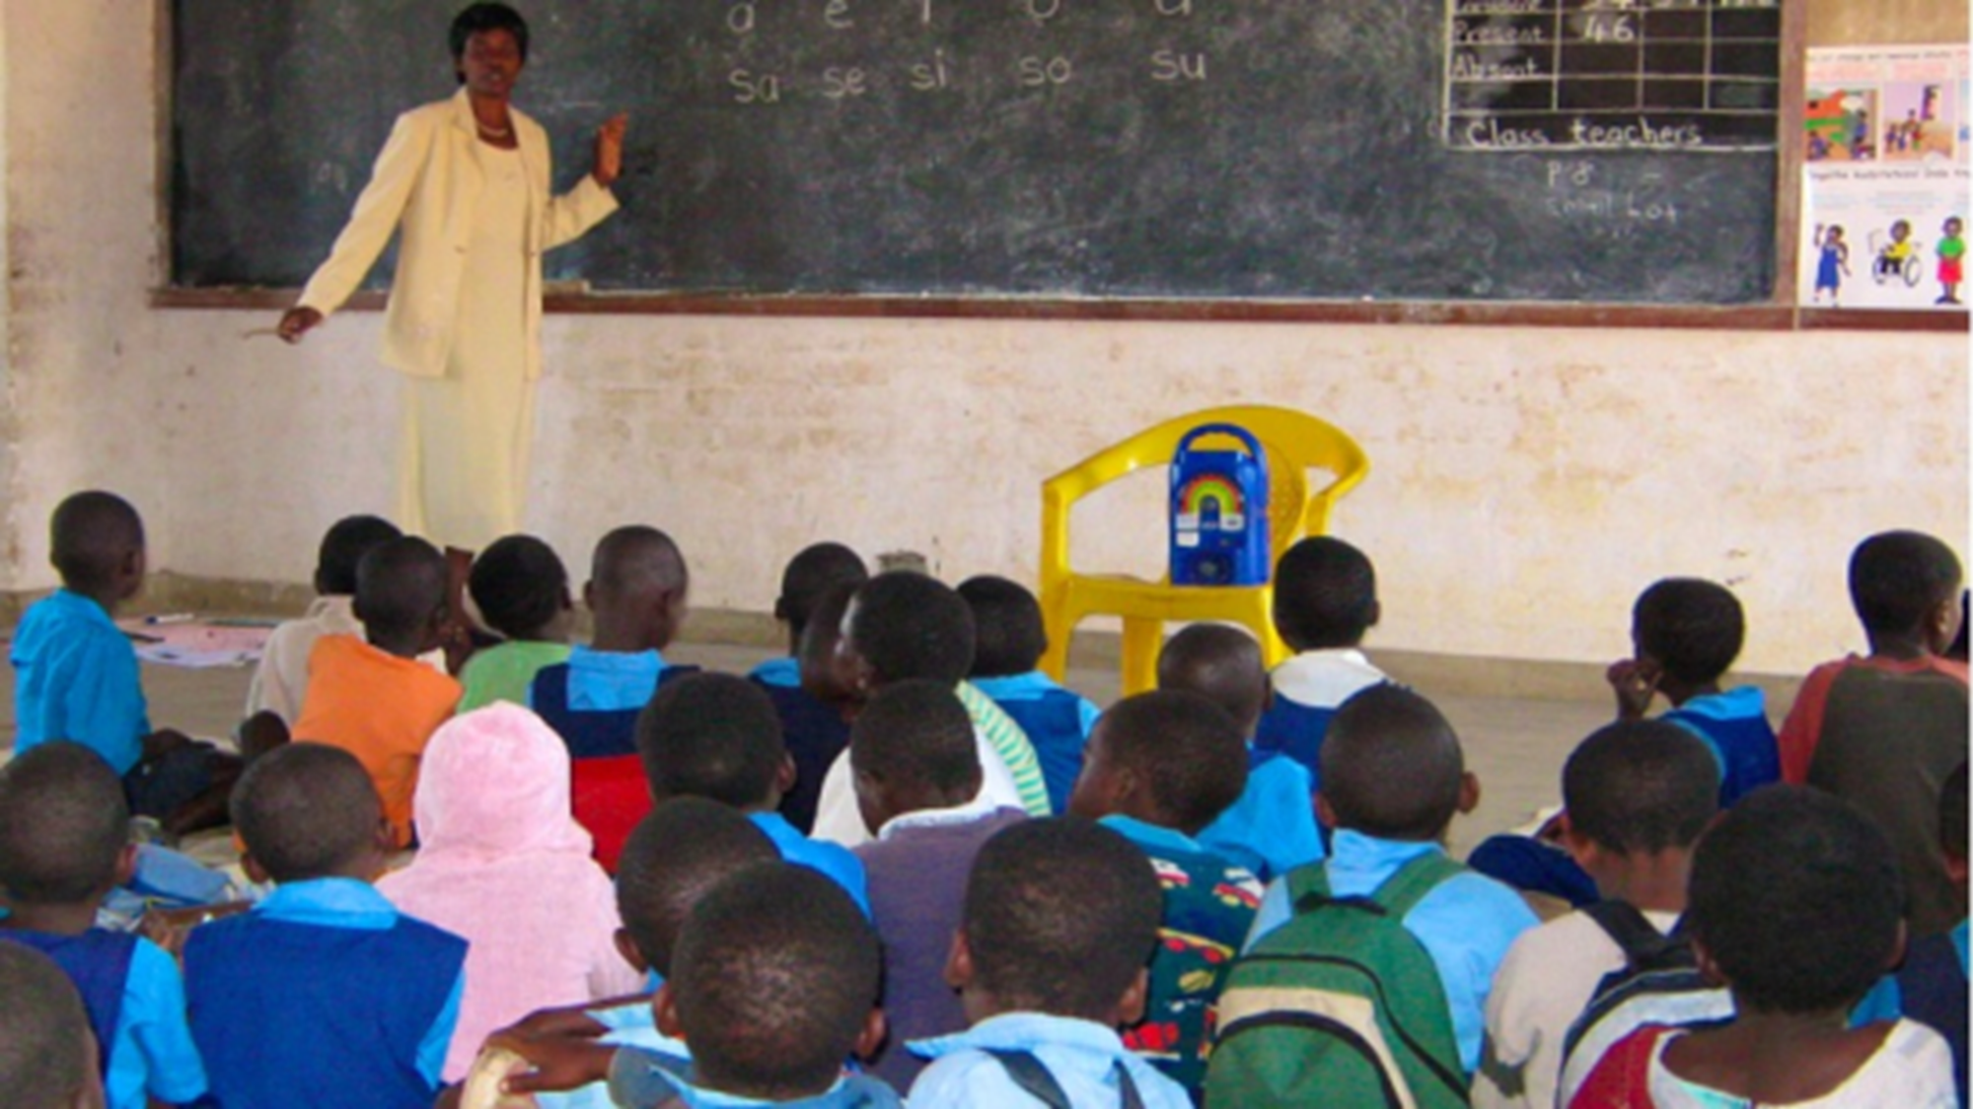
What the Bible says about….. “Disciplining children”
INSTRUCTION
Prov. 1:8
Prov. 13:1
Deut. 4:1-9
Deut. 6:1-9
Teach it all the time
Have reminders everywhere

Slide 3
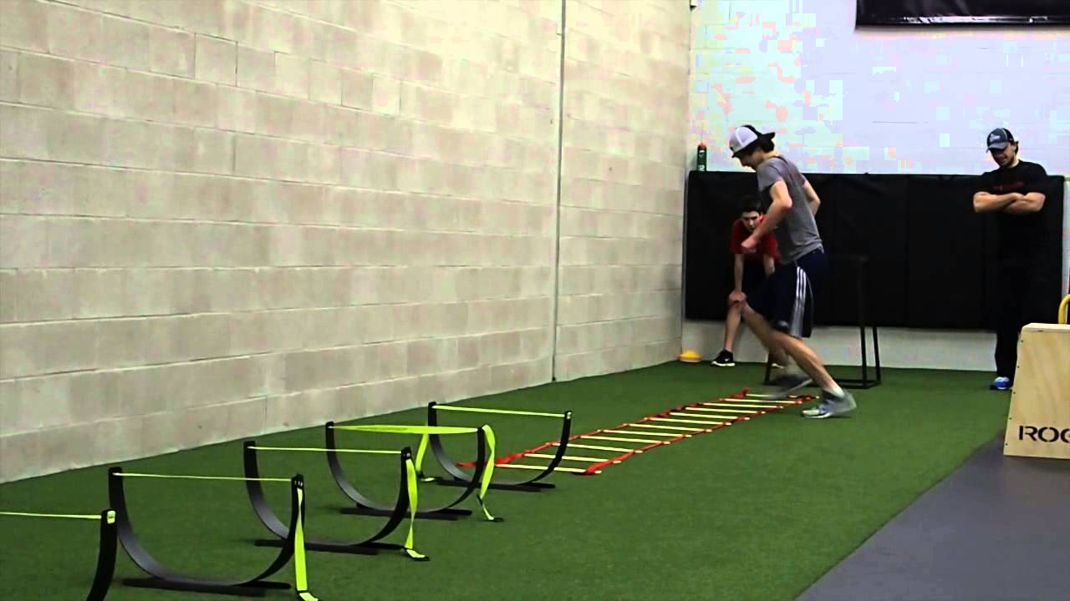
What the Bible says about….. “Disciplining children”
TRAINING
Prov. 22:6
I Tim. 4:7-8
Greek word in verse 7 is “gumnadzo” and means practice, train, exercise.
Greek word in verse 8 is “gumnazia”
We must put our knowledge into practice.

Slide 4
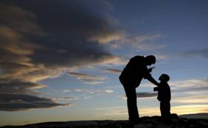
What the Bible says about….. “Disciplining children”
CORRECTION
Prov. 15:10
Prov. 22:15
Prov. 23:13
Heb. 12:6-11
Correction is not pleasant but is to be done in “love.”

Slide 5
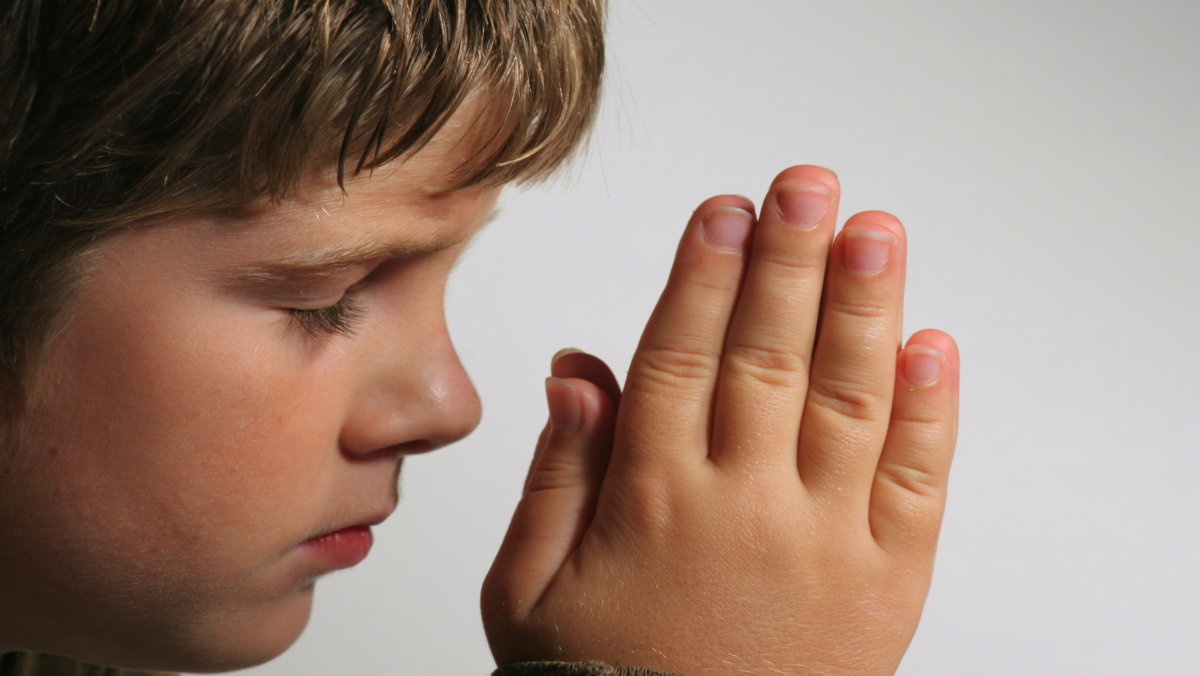
What the Bible says about….. “Disciplining children”
ADMONITION
Eph. 6:4
Also rendered as instruction
Greek word “nouthesia”
Nous means intellect, mind, understanding.
Theo means to place as in a position. The position of kneeling or bowing.
So we must “BRING THEM UP” by “bringing them down” into submission to God.
James 4:10, I Peter 5:6

