Slide 1
Dad’s Are Awesome!
But…

Slide 2
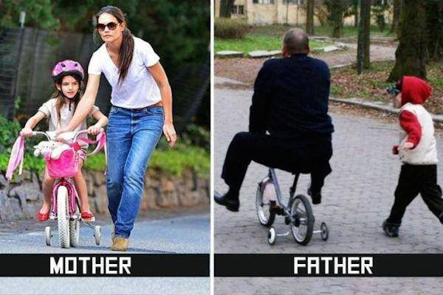

Slide 4
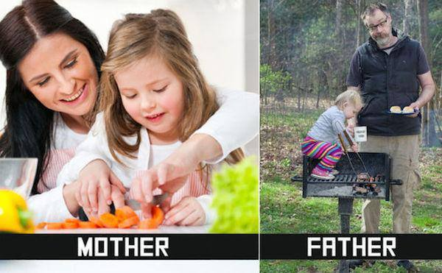

Slide 6
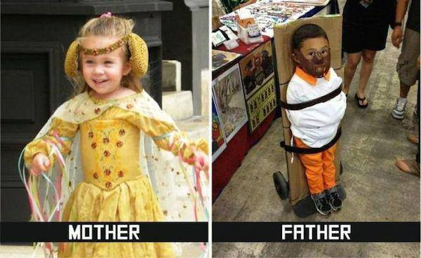

Slide 9
Dad’s are awesome…but…
There’s no doubt about it. Dads are a special thing.
There’s no doubt Dad’s need some help.
Who better to turn to than our Heavenly Father?
“His divine power has granted to all us all things that pertain to life and godliness” 2 Pet 1:3
So if it’s good for Dad, it’s good for everyone!
Disclaimer: Every Dad would be lost without Mom!

Slide 10
Dad’s become MORE awesome when we try to imitate God by…
Doing really hard stuff!

Slide 11
Doing really hard stuff!
“Some assembly required”.
Sometimes it is just telling those little ones (or not so little ones) “no”. Discipline is hard! Heb 12:5-11.
Sometimes it will be letting go. Can you imagine how hard it was for God to let go of Jesus? How badly did he want to keep him close? 1 Jn 4:7-11
God willingly allowed Jesus to leave Heaven knowing that some people would not Love him.

Slide 12
Dad’s become MORE awesome when we try to imitate God by…
Having an even temperament!

Slide 13
Having an even temperament!
Clearly one of my strong points. I’m getting better!
Like our heavenly father, we need to be patient and not quick to fly off the handle. James 1:19-21.
Our anger can not produce God’s righteousness.
Look how patient God was with individuals like Paul and the many people mistreating Jesus.
Patience, Kindness, Gentleness, & Self Control! All influence temperament. Galatians 5:22.

Slide 14
Dads become MORE awesome when we try to imitate God by…
Letting our children learn hard lessons!

Slide 15
Letting our children learn hard lessons!
James 1:2-3. We will all have scrapes and bruises along the way. Each one prepares us for the next.
Dad’s should be equipping their children with Godly wisdom to rely on daily as they grow.
Every scenario should be filtered through Christ.
It’s not the Father’s job to put that advice and decision making into motion. Why do we fall?

Slide 16
Dads become MORE awesome when we try to imitate God by…
Wanting what is best for our children!

Slide 17
Wanting what is best for our children!
This one is really simple. Want what God wants. 2 Peter 3:8-9. Acts 17:30-31. Are your goals Godly?
God wants every soul to be saved, but He knows that many will not be. How heartbreaking for Him to have them choose otherwise.
Want your children to be devoted to Christ. Do they know it’s most important to you? Eccl 12:13

Slide 18
Dads become MORE awesome when we try to imitate God by…
Answering ALL the questions!!

Slide 19
Questions Anna Claire has asked…this week.
What’s a vagabond?
Can foxes fly?
What’s harmony?
How can I bring my family honor?
Why are some things blue?
Why isn’t that woman working?
Is that Mulan?
How are books made?
Why do birds migrate?
What is locomotion?

Slide 20
Answering ALL the questions!
If you’ve raised little ones, you know what I’m talking about. It’s been estimated that the AVERAGE kid asks 350-400 questions a day. That’s once every 99 seconds.
Thankfully God has already answered those questions that are most important for us!
Really there are three questions that I would call “most important”. All other questions fall under this umbrella.
How do I become a Christian? How do I remain faithful to God? Can you do that and remain faithful to God?

Slide 21
Dads are AWESOME…but… God can help us be more awesome when we try to imitate HIM by…
Doing really hard stuff!
Having an even temperament!
Letting our children learn hard lessons!
Wanting what is best for our children!
Answering ALL the questions!

