Slide 1
How to Keep Growing as a Christian!

Slide 4
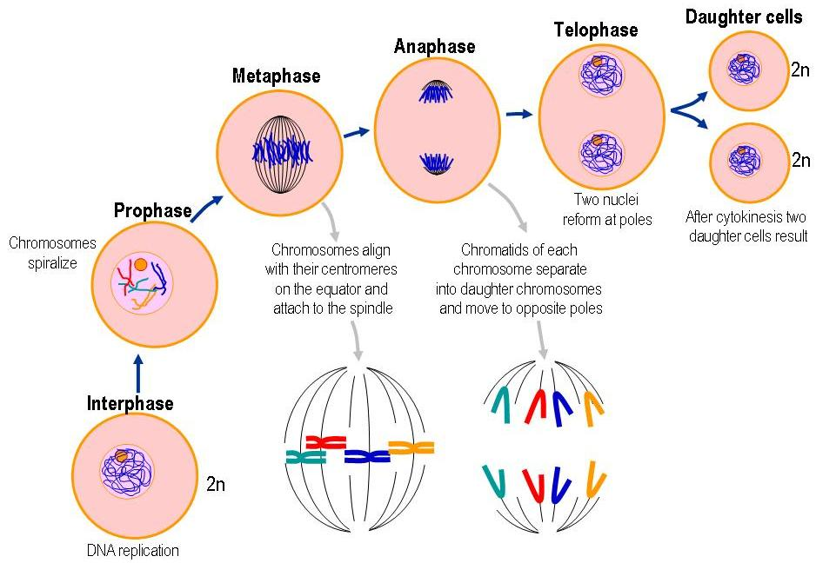

Slide 5
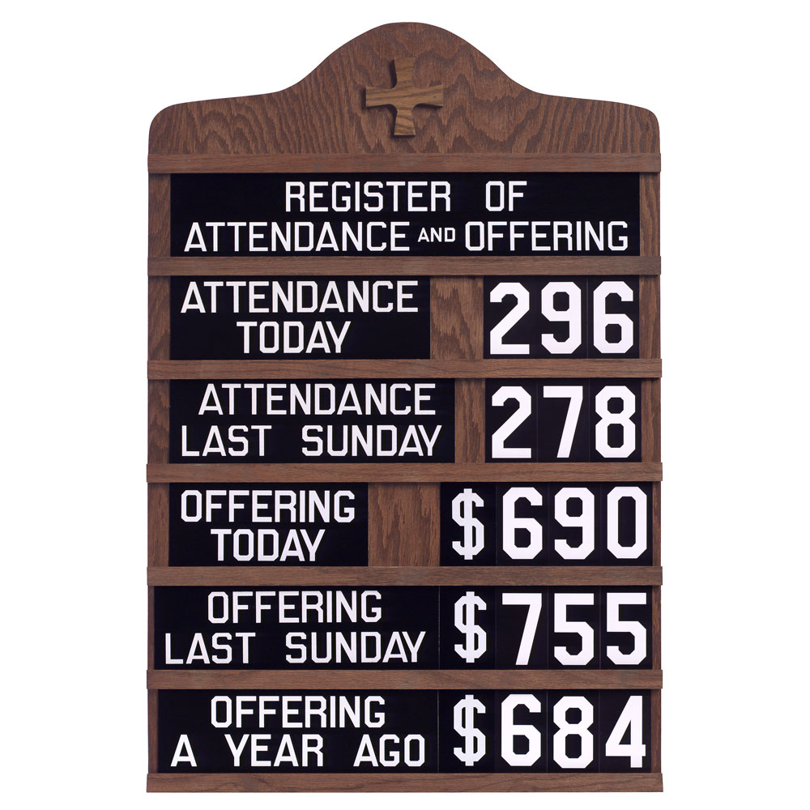

Slide 6
Life is tough! Get a helmet!
Life can be filled with many ups and down.
Sometimes those peaks seem all to brief while the valleys are much to long. Genesis 37-41.
Often times if we aren’t careful we might enter a state of “un-growth”. 1Cor 10:12
This is where we kind of plateau or stagnate in our Christianity instead of seeing steady growth. John 15.

Slide 7
6 EASY tips to make sure that we are involved in CONTINUAL GROWTH in Christ.

Slide 8
1. Go to God daily in Prayer!
This is something we should be doing. It’s so easy and so easily neglected. Acts 1:14
John 15:7 – God wants us to abide in Him.
Have a prayerful mindset – 1 Thess 5:17
Don’t make prayer harder than it’s supposed to be. Romans 1:8
God is our Father and talking to our Father should bring us peace. James 5:13

Slide 9
2. Read God’s Word Daily!
Again, here is one of those things that we all agree on, but rarely devote ourselves to! Acts 2:42. Psalm 118:48. Acts 17:11
Make time to not only “read” God’s word, but to study it and then put it into practice.
It’s been said and theorized that a habit can be made or broken in as short a time as two weeks. Ezra 7:10

Slide 10
3. Obey God, moment by moment!
Many of us at times may have asked ourselves: “Do I really love God/Jesus?”
One of the ways that can be answered is by asking a follow up: “Do I obey Them?” John 3.
Obedience is a big deal to God. 1 Sam 15:22. Ax 5
This obedience doesn’t stop at “Obeying” the Gospel. It begins a lifelong effort of obeying God and his Word. 1 John 5:2-3.

Slide 11
4. Work…Hard. Do stuff!
Growing Christians are Christians who are busy – not busy bodies, but busy bees! 2 Thess 3:11
A follower of Jesus is a worker! John 9:1-7
People should see our good works. Matthew 5:14-16 – Not for OUR glory, but for HIS!!!
Pick up heavy stuff! The heavy stuff: each other, the lost, the hurt, the sin sick, the grieving, the naked, the hungry, the imprisoned, and even our enemies. The least of these. Matt 25! Do Work!

Slide 12
5. Trust God with every detail of your life!
A healthy sheep trusts the shepherd. Psalm 23.
TRUST. THE. SHEPHERD. John 10:1-5.
Psalm 37:5. God wants in on every part of your life. Don’t exclude him. If you don’t think God would want in to that particular part of your life, then I’ll bet that’s a part of your life that needs changing. Proverbs 3:5-6.

Slide 13
6. Hold on, no matter what!
There will be turbulence on this flight. God doesn’t guarantee a flight without turbulence, but he does guarantee a safe landing. Heb 10:35-36.
God rewards those who seek him. Seek him with diligence. Hebrews 11:6
Twice in Revelation 2 John spoke to two angels of churches in Smyrna and Thyatira entreating both of them to “be faithful unto death” and “hold fast what you have”.
It will be worth it. Revelation 21:1-4.

Slide 14
How can we have continual GROWTH in Christ?
Go to God daily in prayer!
Read God’s word daily!
Obey God, moment by moment!
Work…Hard. Do stuff!
Trust God with every detail of your life!
Hold on, no matter what!

