Slide 1
Keeping the Train on the Tracks
Secrets of Decision Making

Slide 2
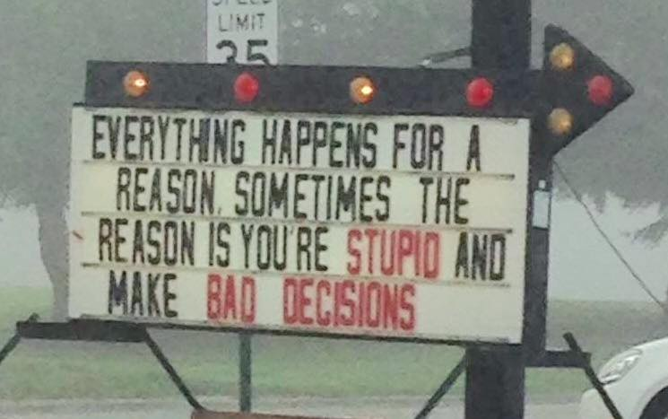

Slide 3
Joel 3:14 Multitudes, multitudes in the valley of decision! For the day of the LORD is near in the valley of decision.

Slide 4
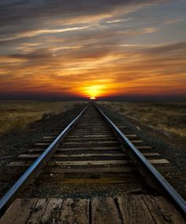
Consider what the Bible says about it.
Pray about it.
Pay attention to your conscience.
Choose what is best for you not others.
Be realistic.
Ask for advice.
Consider if it will bring you peace or problems.

