Slide 1
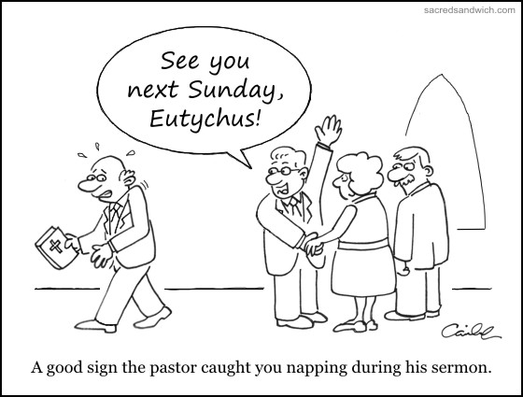
Serving the Lord with Gladness: GETTING MORE OUT OF THE PREACHING
A GOOD SIGN THAT YOUR PREACHER CAUGHT YOU NAPPING DURING SERVICES

Slide 2
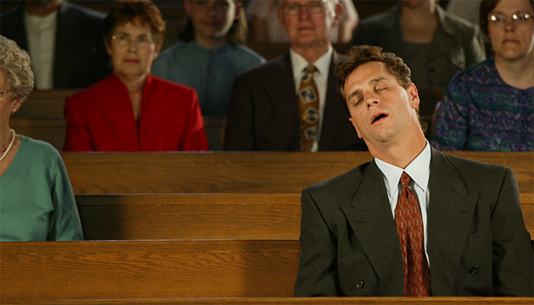
Serving the Lord with Gladness: GETTING MORE OUT OF THE PREACHING
Text: II Tim. 4:2
How does the preaching affect you?
BORED!!

Slide 3
Serving the Lord with Gladness: GETTING MORE OUT OF THE PREACHING
Informed & Engaged!!

Slide 4
Serving the Lord with Gladness: GETTING MORE OUT OF THE PREACHING
We need to appreciate the benefits of preaching.
Preaching can be ……………………
A BLESSING TO THE HEARER
Romans 10:14-17, John 20:30-31
CONVICTING TO THE HEARER
Acts 2:37
Have you ever felt guilty after listening to a sermon?

Slide 5
Serving the Lord with Gladness: GETTING MORE OUT OF THE PREACHING
Preaching can be ……………………
EDUCATING TO THE HEARER
Learn how to become a Christian.
Learn how to become a better person.
Learn how to avoid apostasy- Heb. 2:1-3
INSPIRING TO THE HEARER
Acts 2, Colossians 1:3-6

Slide 6
Serving the Lord with Gladness: GETTING MORE OUT OF THE PREACHING
Preaching can be ……………………
ENJOYED MORE WITH A FEW PRACTICAL APPLICATIONS
Listen from beginning to end.
Look at the preacher.
Read along with your Bible.
Listen with a mind to act.

